Slide 1
105 Review
Jerika McKeon
You will need your CID for the exam- Memorize it!!!!!

Slide 2
Other Reviews
Fri 1-3 108 MARB
This is a weekly review, so feel free to come at any time during the semester.
We cover general concepts as well as problems from the book and from the homework.
Come with questions!!

Slide 3
Concepts
Algebra
Trig
Motion in 1-D
Motion in 2-D /Vectors (projectiles)
Newton’s Laws of Motion & Forces
Rotational Motion & the Law of Gravity

Slide 4
Algebra & Trigonometry
Sin, Cos, Tan
Degrees vs Radians
for this test you only need Degrees
Pythagorean Theorem

Slide 5
Motion in 1-D
Distance vs Displacement: What’s the difference?
Speed vs Velocity : What’s the difference?
Initial
Final
Average
Instantaneous
What does it mean to have +v vs –v vs v=0?
Acceleration
Average
Instantaneous
What does it mean to have +a vs –a vs a=0?
Graph Analysis
Kinematic Equations

Slide 6
Motion in 2-D
Vectors (know trig)
Relative velocity
Kinematic Equations
How to solve Projectile Problems (my strategy)
Make a table of x and y information:
Usually, you’ll use one of the directions to solve for time, then use time with the information in the other direction to find whatever you’re looking for
Make sure you are solving for the MAGNETUDE when they ask you for it, don’t just find a component of the vector

Slide 7
Newton’s Laws
1st Law:
An object with a constant velocity (including v=0) will continue moving (or not moving) with that velocity unless acted upon by an outside force.
2nd Law:
F=ma
3rd Law:
“Every action has an equal and opposite reaction.”
If I push on the block, it’s pushing back on me
They why does only one thing move?

Slide 8
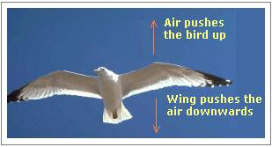
Newton’s 3rd Law Bird Example
Consider the flying motion of birds. A bird flies by use of its wings. The wings of a bird push air downwards.
Since forces result from mutual interactions, the air must also be pushing the bird upwards.
The size of the force on the air equals the size of the force on the bird; the direction of the force on the air (downwards) is opposite the direction of the force on the bird (upwards).
For every action, there is an equal (in size) and opposite (in direction) reaction.
Action-reaction force pairs make it possible for birds to fly.

Slide 9
Newton’s 3rd Law Bullet Example

Slide 10
Newton’s 3rd Law Equillibrium Example
http://hyperphysics.phy-astr.gsu.edu/hbase/newt.html#nt3x

Slide 11
Forces
Force due to Gravity
Normal Force
Friction
Static vs Kinetic
Tension
2 Body problems (pulleys, 2 blocks, etc.)
What does it mean when forces balance?
Solving a Force Problem
Draw a picture
Draw a FBD
Write out the Force Summation Statements

Slide 12
Rotational Motion & The Law of Gravity
Centripetal force is an imaginary force, kind of like a category of forces
Centripetal Force- the NET force causing an object to move in a circle
Which force would you have to remove to let the object move in a straight line?
F=ma
Orbiting Problems

Slide 13
ANNOUNCEMENT!

Slide 14
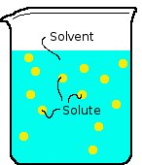
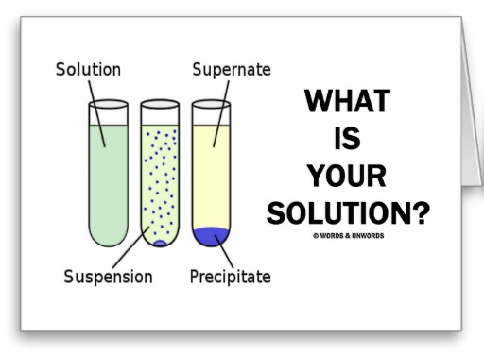
Solutions
Solution = solute + solvent
Example: Sugar Water
Solute = sugar
Solvent = water
A mixture is when the substances don’t dissolve in each other. Ie. Oil & Water

Slide 15
Any more questions?
Thanks for coming! Don’t forget to sign the paper please!

