Slide 1
Unit 4 (Sound) Review
Jerika McKeon

Slide 2
Vibration & Waves: General Equations
Blueprint Equation: v=λf
f=1/T
ω=2πf

Slide 3

Springs
k=spring constant and m=mass
ω=$\sqrt{\frac{k}{m}}$
T=$\text{2}\text{π}\sqrt{\frac{m}{k}}$

Slide 4
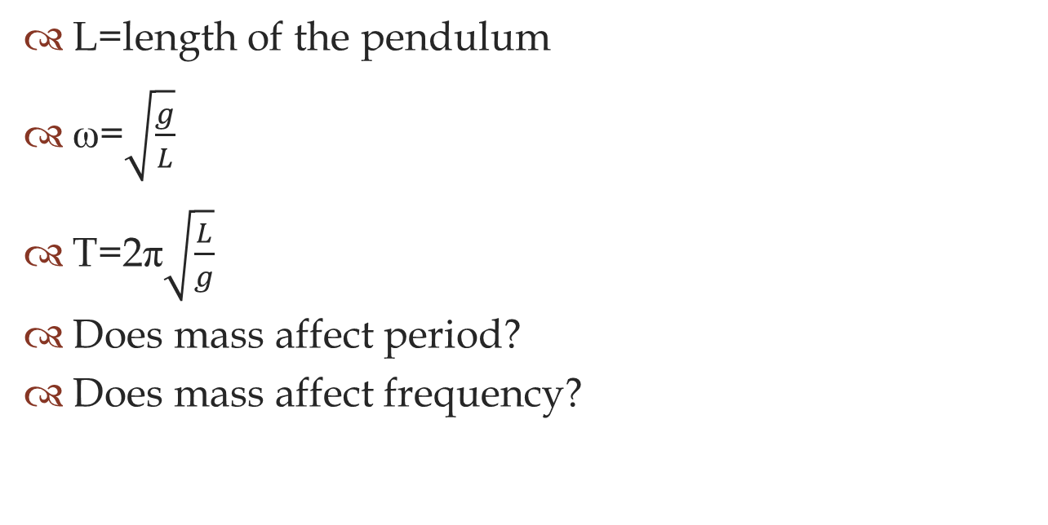
Pendulums
L=length of the pendulum
ω=$\sqrt{\frac{g}{L}}$
T=$\text{2}\text{π}\sqrt{\frac{L}{g}}$
Does mass affect period?
Does mass affect frequency?

Slide 5

Waves on a String
T=Tension & L=length
$μ$=linear mass density=m/L
v=$\sqrt{\frac{T}{μ}}$

Slide 6
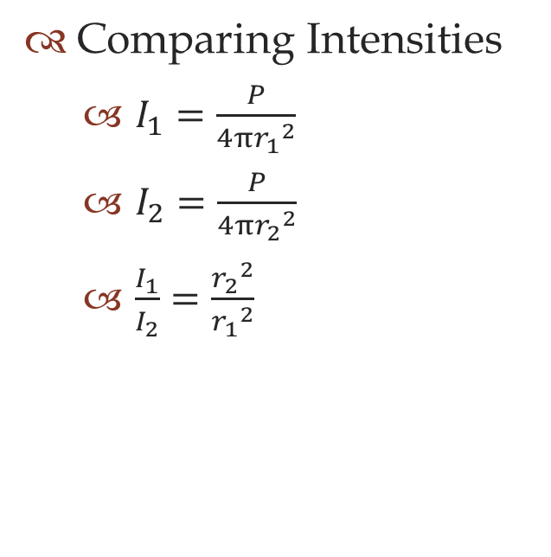
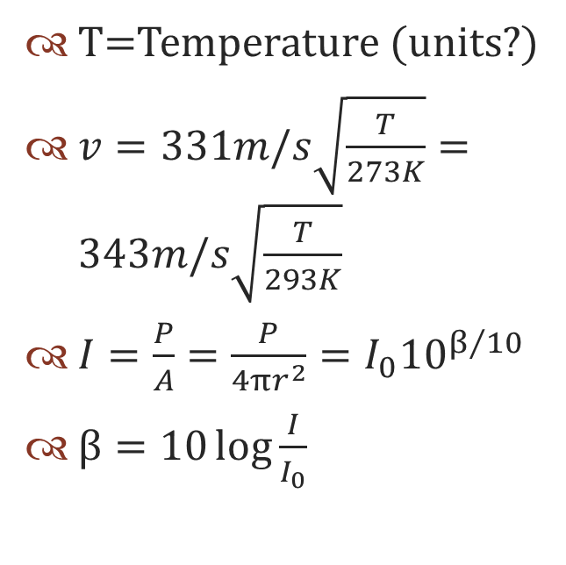
Sound
T=Temperature (units?)
$v=331m/s\sqrt{\frac{T}{273K}}=343m/s\sqrt{\frac{T}{293K}}$
$I=\frac{P}{A}=\frac{P}{4πr^{2}}=I_{0}{10}^{β/{10}}$
$β=10\log{\frac{I}{I_{0}}}$
Comparing Intensities
$I_{1}=\frac{P}{4π{r_{1}}^{2}}$
$I_{2}=\frac{P}{4π{r_{2}}^{2}}$
$\frac{I_{1}}{I_{2}}=\frac{{r_{2}}^{2}}{{r_{1}}^{2}}$

Slide 7

More Sound
Doppler Shifts
$f^{′}=f\frac{v±v_{0}}{v∓v_{s}}$
Sonic Boom
$\sin{θ}=v/{v_{s}}$
Mach Number=${v_{s}}/v$

Slide 8
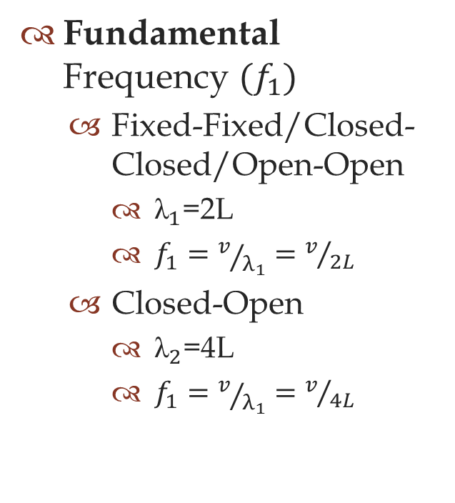
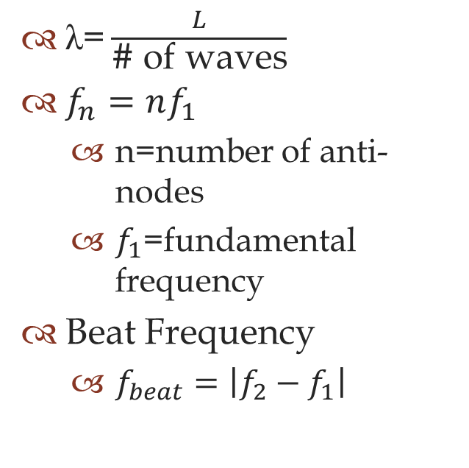
Standing Waves
$\text{λ}\text{=}\frac{L}{\text{\# }\text{of} \text{waves}}$
$f_{n}=nf_{1}$
n=number of anti-nodes
$f_{1}$=fundamental frequency
Beat Frequency
$f_{beat}=\left|f_{2}−f_{1}\right|$
Fundamental Frequency ${(f}_{1})$
Fixed-Fixed/Closed-Closed/Open-Open
${\text{λ}}_{1}\text{=2}\text{L}$
$f_{1}=v/{λ_{1}}=v/{2L}$
Closed-Open
${\text{λ}}_{2}\text{=4}\text{L}$
$f_{1}=v/{λ_{1}}=v/{4L}$

