Slide 1
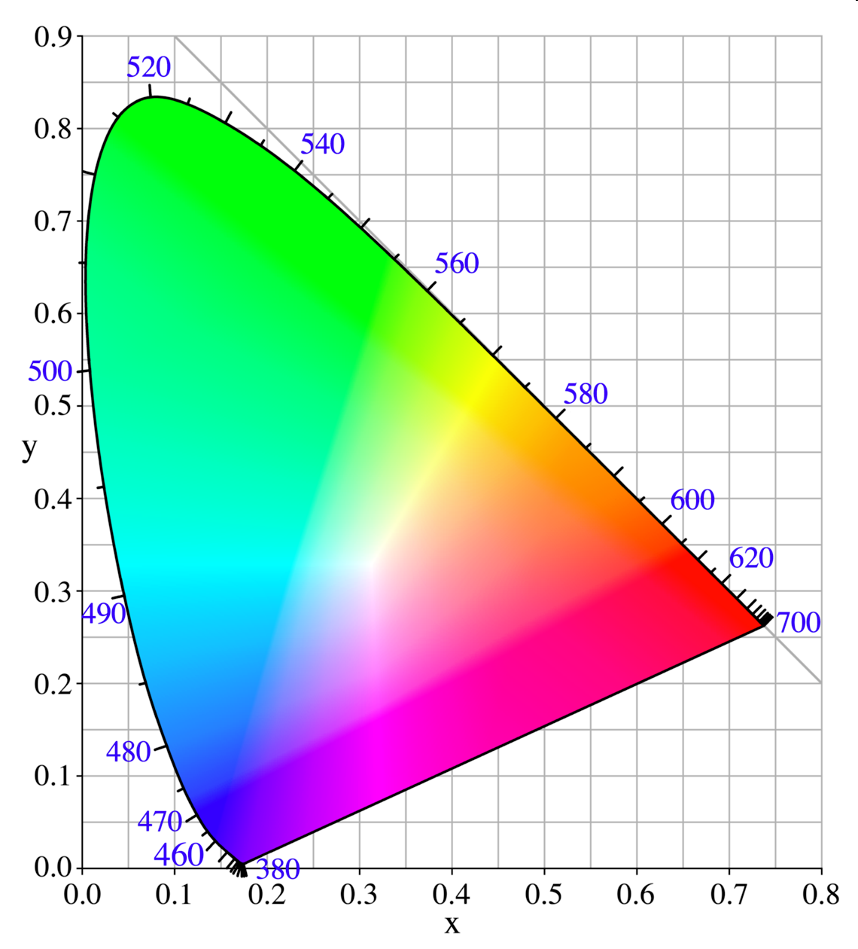
Color! Main Goals:
Understand this thing: “Chromaticity diagram”
Given a spectrum, how to predict what color the spectrum will seem to you

Slide 2
Visible Spectrum
From Wikipedia, “Visible Spectrum”
“All the colors of the rainbow…” → Where is brown?? Where is pink?? Where is turquoise??

Slide 3
Cone cells
From Wikipedia,
“Color Vision”
“Short”
“Medium”
“Long”

Slide 4
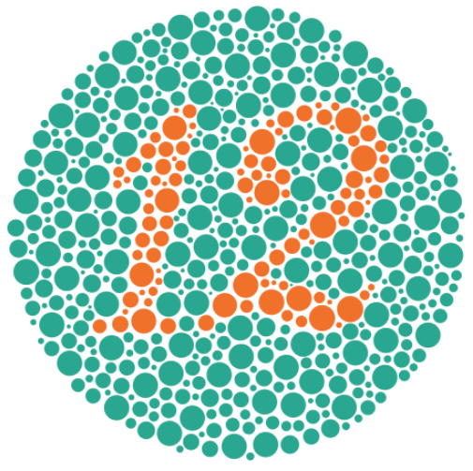
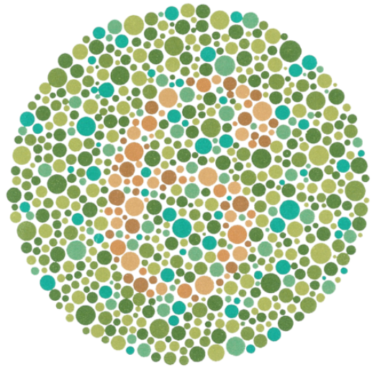
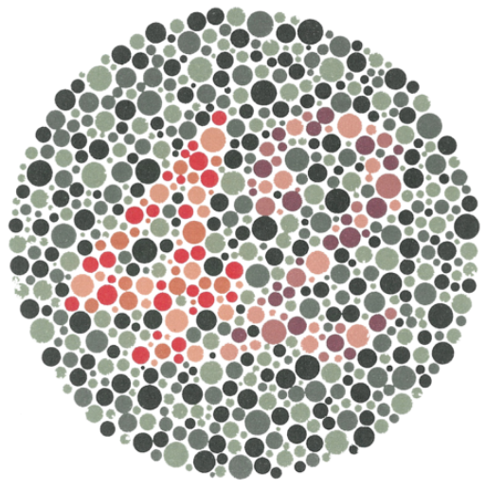
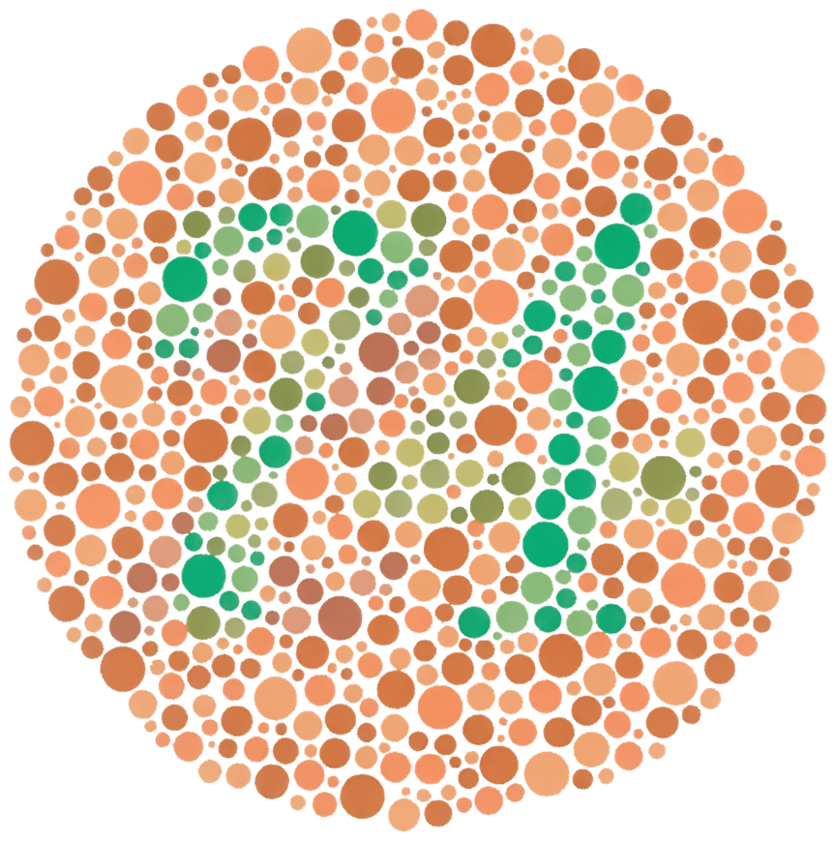
Color blindness
From Wikipedia, “Ishihara test”
tritanopia – lacks S cones, <1% of males and females
tritanomaly – S cones mutated, ~0.01% of males and females
deuteranopia – lacks M cones, ~1% of males
deuteranomaly – M cones mutated, standard “red-green color blindness”, ~5% of European males; far fewer females
protanopia – lacks L cones, ~1% of males
protanomaly – L cones mutated, ~3% of European males, far fewer females
achromatopsia – total color blindness, 0.003% of males and females

Slide 5
Primary Colors
Cone cell response, again
From Wikipedia,
“RGB Color Model”
How the primary song should go
“Additive color mixing”
(Pigments: “subtractive color mixing”)

Slide 6
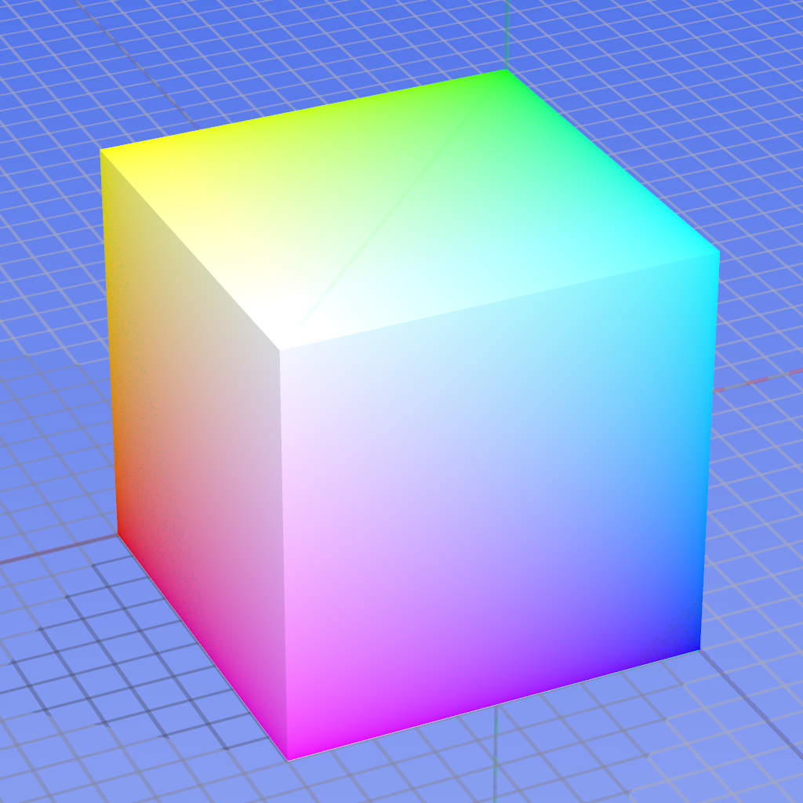
Components of R, G, B: Plot in 3D “color space”
From Wikipedia,
“RGB Color Model” (old version)
Viewing slices of the cube:
https://programmingdesignsystems.com/color/color-models-and-color-spaces/index.html

Slide 7
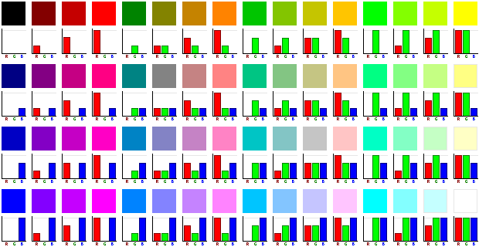
Components of R, G, B
From Wikipedia,
“RGB Color Model” (old version)

Slide 8
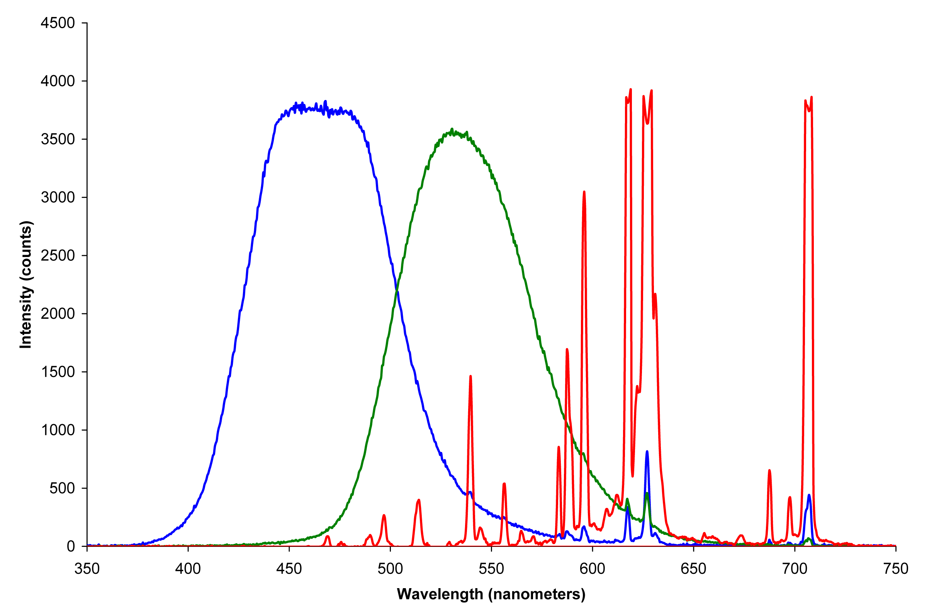
How to Display Colors
From Wikipedia, “Primary Color”

Slide 9
1920’s Color Matching Experiments
Using combinations of these three:
Narrow red source at 700 nm
Narrow green source at 546.1 nm
Narrow blue source at 435.8 nm
How much of each is required to match the wavelengths in the visible spectrum (“pure colors”)?
Cone cell response, again

Slide 10
A Concern
Cone cell response, again
Say you want to mix the dashed lines to look the same as 580 nm orange line.
You may start by turning up the red light. But soon you also need to turn up the green light. However…
Green light will excite some S! (a small amount, but nonzero)
580 nm alone will never excite S! Therefore 580 nm cannot be matched.
You need some “negative blue” to counteract

Slide 11
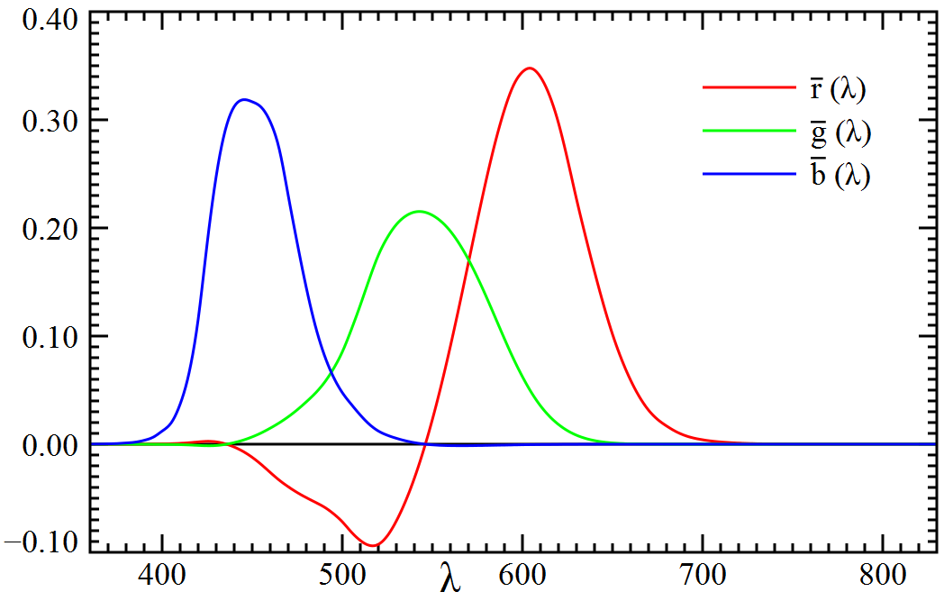
Results: $\overline{r}, \overline{g}, \overline{b}$ functions
red source = 700 nm green source = 546.1 nm blue source at 435.8 nm
to get 700 nm, only need red; $\overline{g}, \overline{b}$ are 0
to get 435.8 nm, only need blue; $\overline{r}, \overline{g}$ are 0
to get 546.1 nm, only need green; $\overline{r}, \overline{b}$ are 0
to get 580 nm orange, need some “negative” blue
From Wikipedia, “1931 Color Space” (also in P&W)

Slide 12
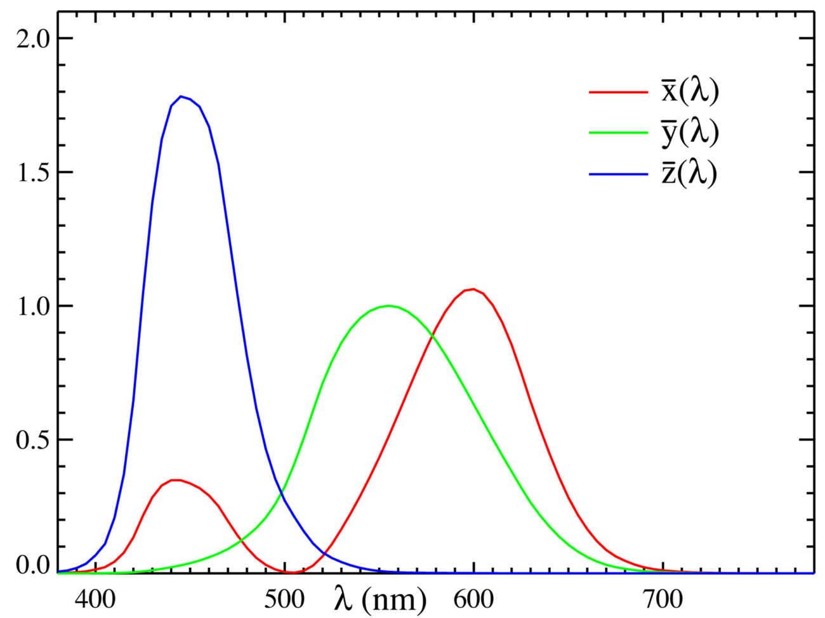
$\overline{x}, \overline{y}, \overline{z}$ functions vs. $\overline{r}, \overline{g}, \overline{b}$ functions
From Wikipedia, “CIE 1931 Color Space”
(Very Important, but not in Peatross & Ware)
all are positive
$\overline{z}$ = close to S cones, close to $\overline{b}$
$\overline{y}$ = matches intensity response of eye, close to M cones
$\overline{x}$ = chosen so that white is equal parts of all three
Cone cell response again

Slide 13
Projections
Given a spectrum I(λ), how much $\overline{x}$, $\overline{y}$, and $\overline{z}$ does it have?
$$X=\int{I\left(λ\right)\overline{x}\left(λ\right)dλ} \\ Y=\int{I\left(λ\right)\overline{y}\left(λ\right)dλ}$$
$$Z=\int{I\left(λ\right)\overline{z}\left(λ\right)dλ}$$

Slide 14
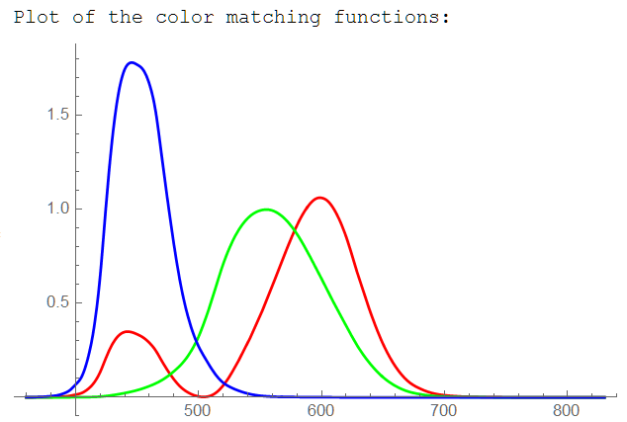
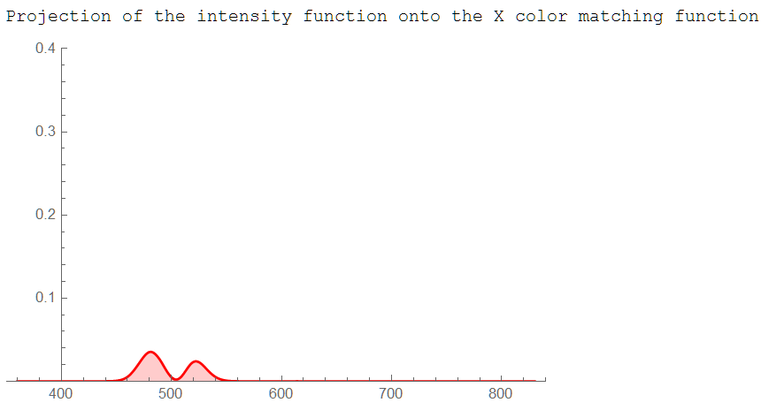
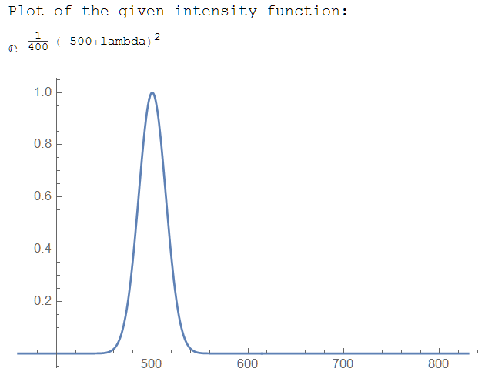
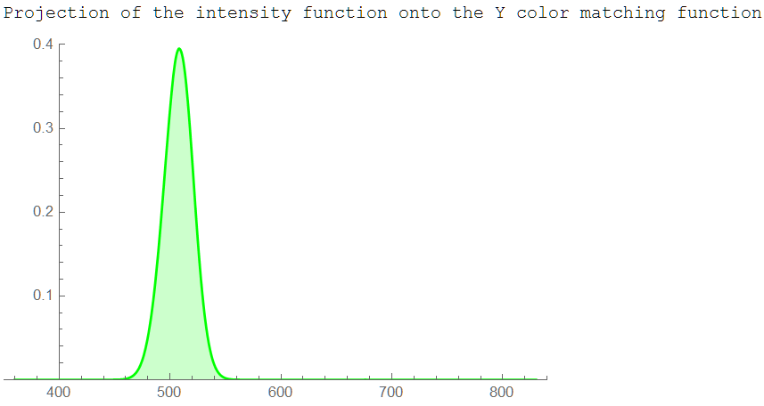
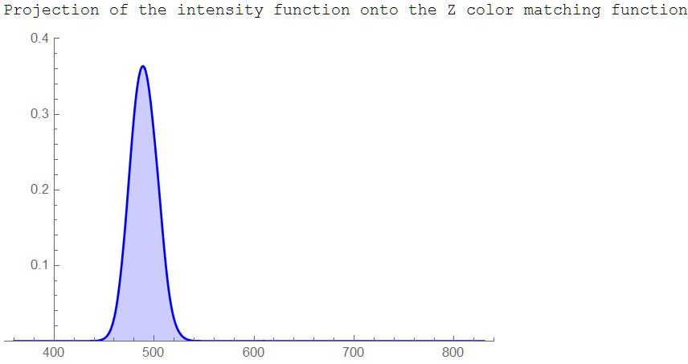
Example from homework (P2.13 part b)
Calculate the areas: X, Y, Z
→ Then normalize so they add up to 1 (call them x, y, z)

Slide 15
Side Note: Linear Transformations of Projection coordinates (X,Y,Z) and (R,G,B)
From P&W
Example 2.4

Slide 16
Worked Example
X =
Y =
Z =
Normalize so they add up to 1 (“color” should not depend on overall intensity)
x =
y =
z = 1 – x – y =

Slide 17
Another Worked Example
What is (x,y) for a delta function at 560 nm?
My estimates:
X = 0.59
Y = 0.98
Z = 0
x = 0.38
y = 0.62
Do that for every wavelength → the “locus” curve

Slide 18
Chromaticity Diagram
Things to observe
The locus curve
Example: 560 nm = (0.38, 0.62)
The white point = (0.33, 0.33)
“Line of purples”
Linear effects
Color mixing along line connecting two points
“Complementary colors”: can mix to get white

Slide 19
Chromaticity Diagram
Hue
Draw the line connecting the white point to P, what λ does it hit? (Example: 593 nm)
Saturation
How far along that line is the point? (Example: 65%)
Brightness
Overall intensity, Not on this diagram
P

Slide 20
Remember this?

Slide 21
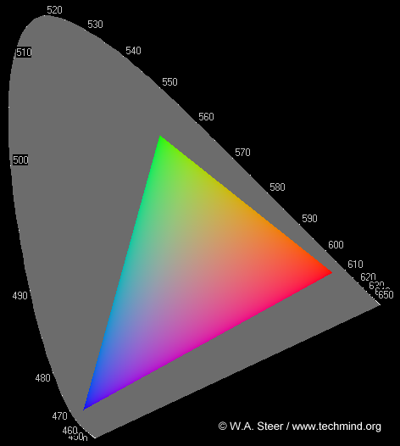
sRGB: three specific color sources
Standard created in 1996 by HP and Microsoft to help the internet
Mixing three sources: triangle called the “gamut”
“green” = (0.30, 0.60)
“red” =
(0.65, 0.33)
“blue” = (0.15, 0.06)

Slide 22
Review (end of Monday’s class?)
Three types of cones responsive to three different wavelength ranges (short, medium, long, aka SML)
Three dimensional color space (RGB)
Color matching experiments produced $\overline{r}, \overline{g}, \overline{b}$ “color matching functions”
Alternate set developed with better properties, $\overline{x}, \overline{y}, \overline{z}$
X,Y,Z are the projections of a given spectrum on to the $\overline{x}, \overline{y}, \overline{z}$ functions
x,y,z are the normalized X,Y,Z values
x,y are the chromaticity coordinates (z is superfluous), can be plotted on the chromaticity diagram
Colors on the chromaticity diagram combine linearly
Actual RGB sources fall on the chromaticity diagram, their enclosed triangle is the gamut of possible colors they can display

Slide 23
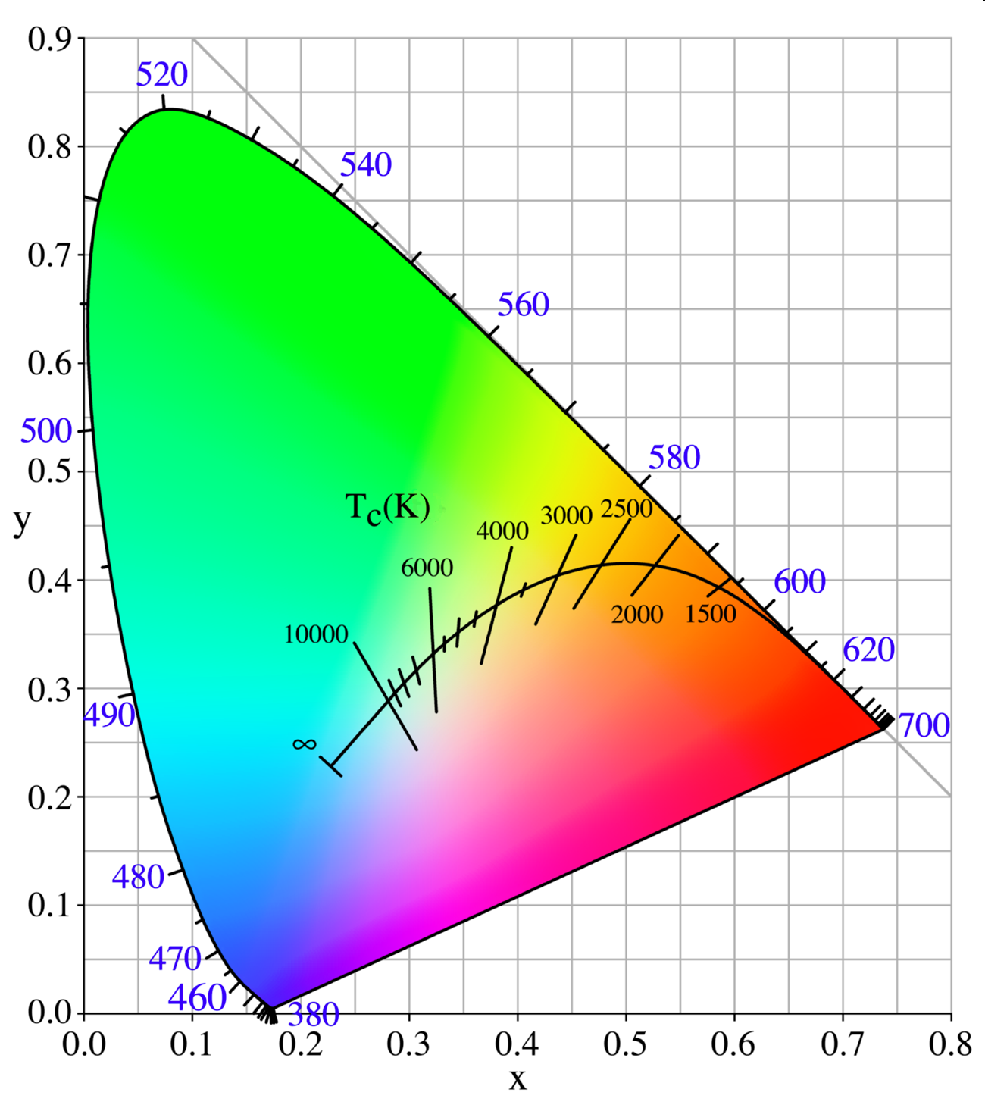
What’s the Color of Blackbody Radiation?
From Wikipedia “Color Temperature”

Slide 24
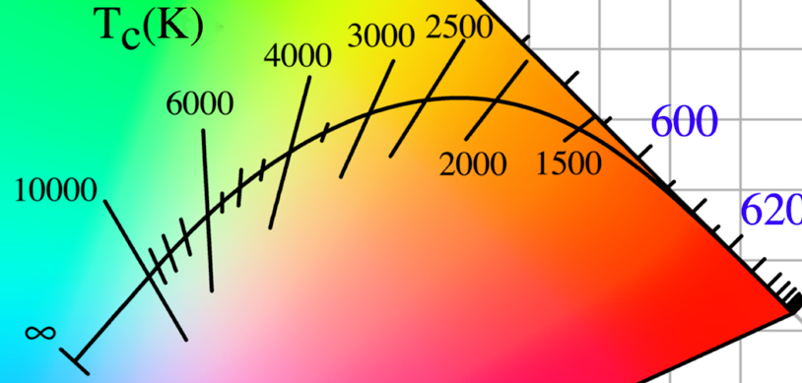
Color of the Sun? T = 5778K

Slide 25
Complementary colors
What is the hue of this point P?
Complementary color, λ_{C}
P

Slide 26
XYZ to sRGB
From P&W P2.14
Step 1: linear transformation
Step 2: nonlinear (function given in P2.14)
Normalize R,G,B values to be integers from 0 to 255
256×256×256 = 16,777,216 possible colors
“green” = (0.30, 0.60)
“red” =
(0.65, 0.33)
“blue” = (0.15, 0.06)

Slide 27
xyY
Reminder: what was Y?
all are positive
$\overline{z}$ = close to S cones, close to $\overline{b}$
$\overline{y}$ = matches intensity response of eye, close to M cones
$\overline{x}$ = chosen so that white is equal parts of all three

Slide 28
XYZ ↔ xyY Transformations
(Nonlinear)
$\left[\begin{matrix}x \\ y \\ Y\end{matrix}\right]=\left[\begin{matrix}\frac{X}{X+Y+Z} \\ \frac{Y}{X+Y+Z} \\ Y\end{matrix}\right]$
$\left[\begin{matrix}X \\ Y \\ Z\end{matrix}\right]=\left[\begin{matrix}\frac{x}{y}Y \\ Y \\ \frac{1−x−y}{y}Y\end{matrix}\right]$

Slide 29
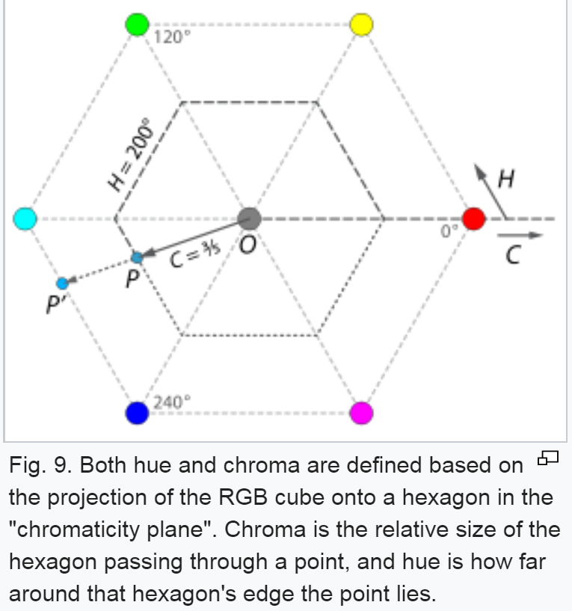
“Hue, brightness, saturation”
Hue – use RGB values to turn locus into a hexagon, then written as 0 to 360°
Saturation called “chroma”, as before
Brightness from Y, scaled as 0 to 1
From Wikipedia “HSL and HSV”

Slide 30
sRGB gamut, again
What would be the ideal set of three light sources for your monitor?
“green” = (0.30, 0.60)
“red” = (0.65, 0.33)
“blue” = (0.15, 0.06)

Slide 31
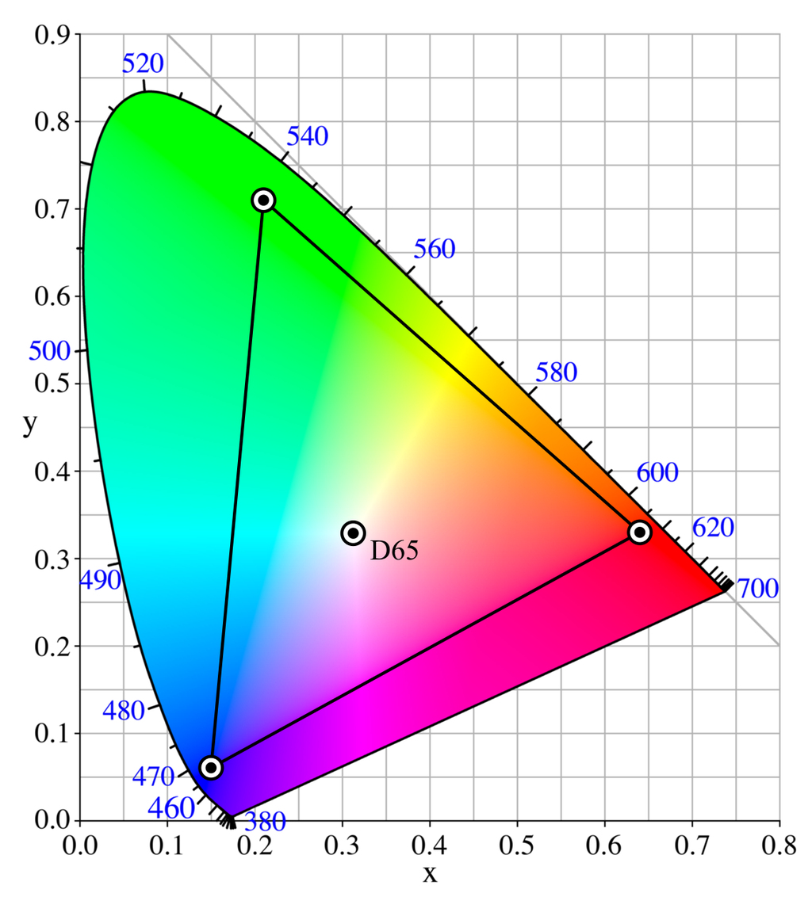
Adobe RGB
Better than sRGB?
Only if your camera/display/ printer are all calibrated for it
Not for use on internet
Also: there’s a wider range of possible colors, but the difference between individual colors is bigger than in sRGB (still 256×256×256)
P
From Wikipedia,
“Adobe RGB color space”

Slide 32
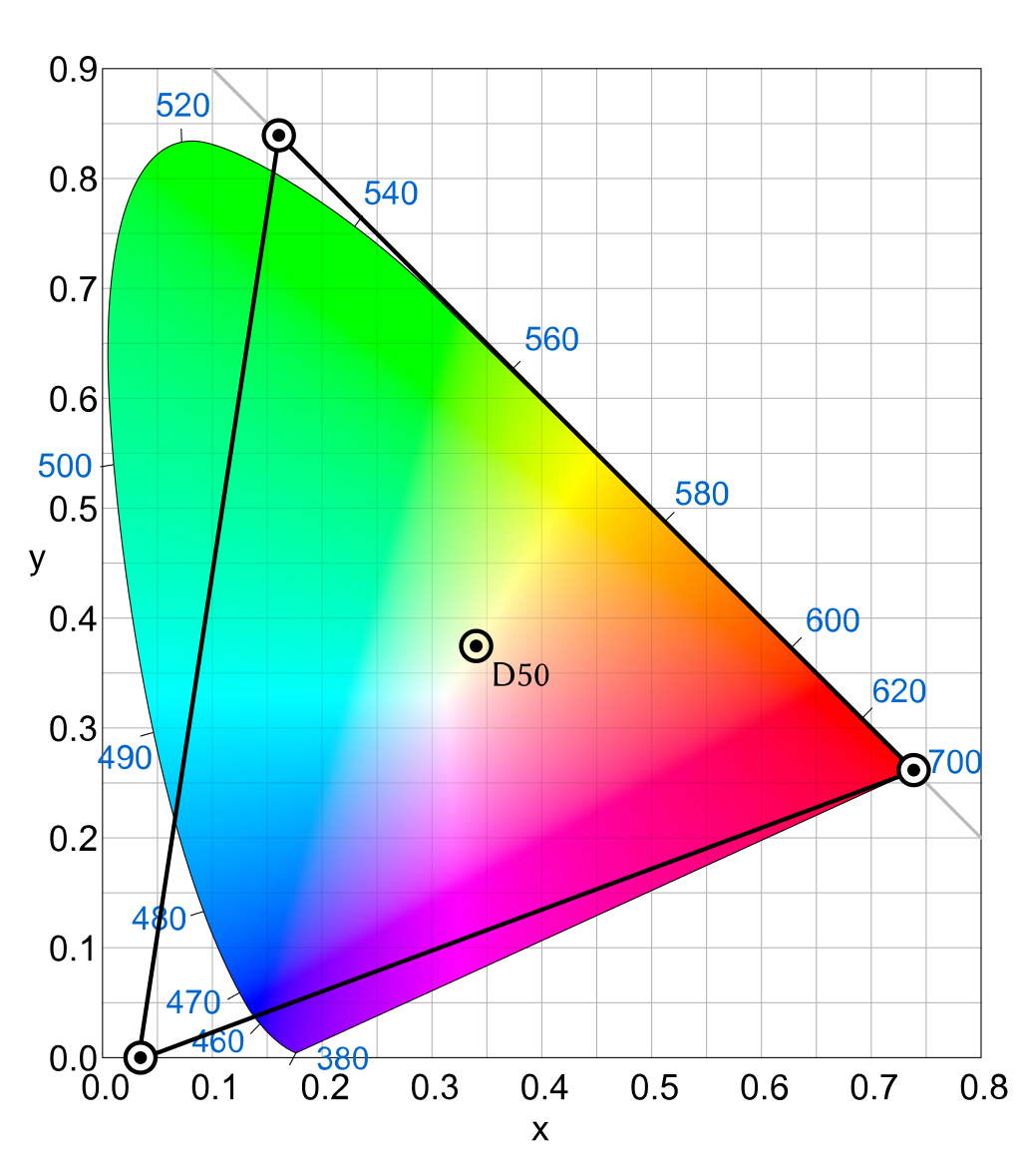
ProPhoto RGB
“One of the downsides to this color space is that approximately 13% of the representable colors are imaginary colors that do not exist and are not visible colors.”
P
From Wikipedia,
“ProPhoto RGB color space”

Slide 33
Summary: Many Ways to Specify Color
R,G,B (original color matching functions)
X,Y,Z
x,y,Y
hue, saturation, Y
→ Complementary hue if needed
hue, brightness, saturation
sRGB R,G,B coordinates (if in sRGB color space)
R,G,B coordinates of other color spaces
That’s All, Folks

