Slide 1
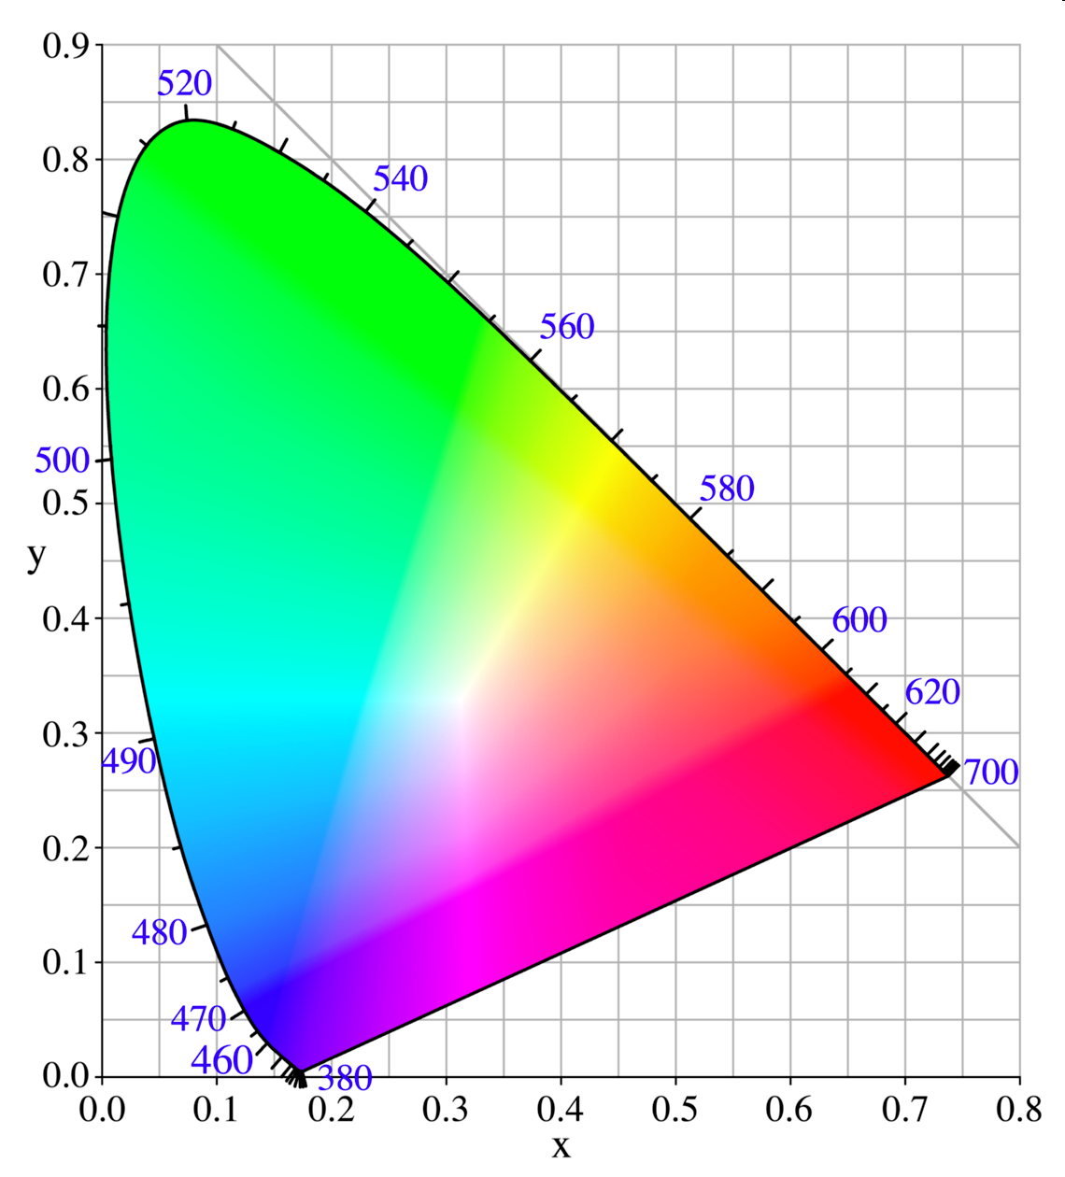
Color! Main Goals:
Understand this thing: “Chromaticity diagram”
Given a spectrum, how to predict what color the spectrum will seem to you

Slide 2
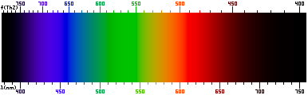
Visible Spectrum
From Wikipedia, “Visible Spectrum”
“All the colors of the rainbow…” → Where is brown?? Where is pink?? Where is turquoise??

Slide 3
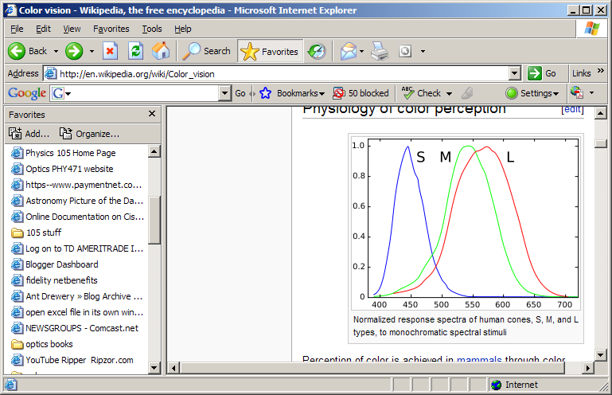
Cone cells
“Short” “Medium” “Long”
From Wikipedia, “Color Vision”

Slide 4
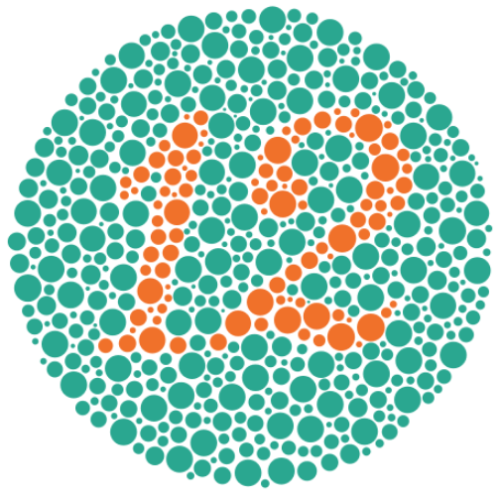
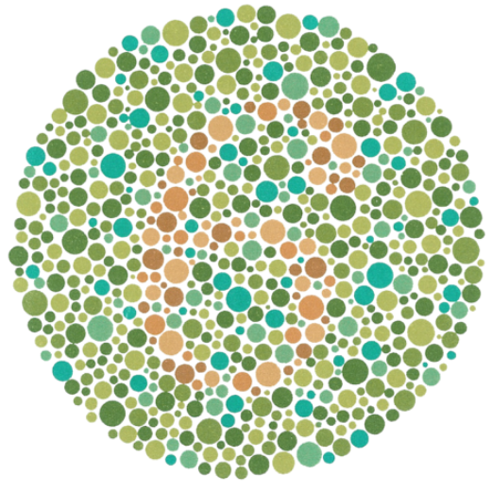
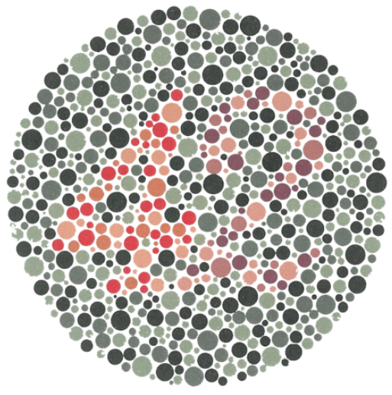
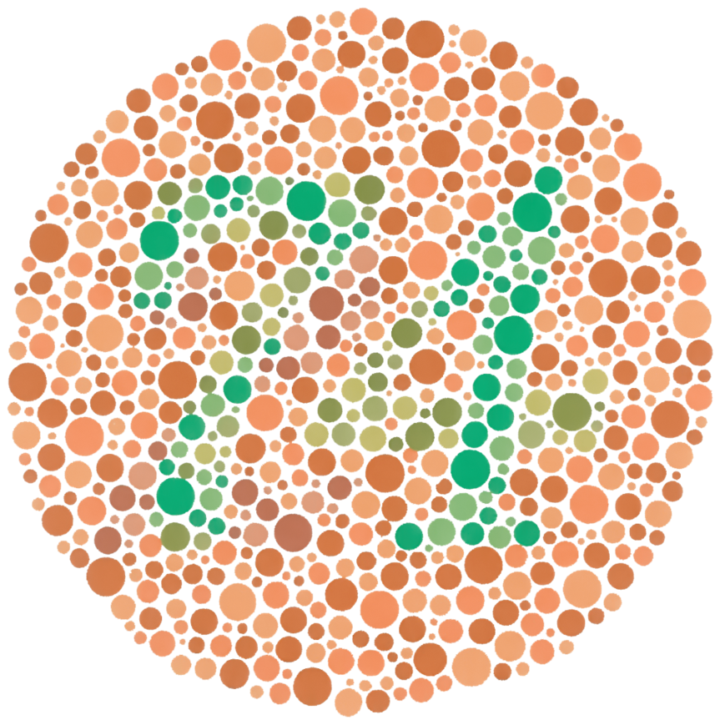
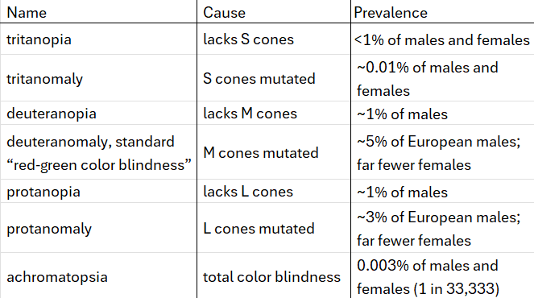
Color blindness
From Wikipedia, “Ishihara test”

Slide 5
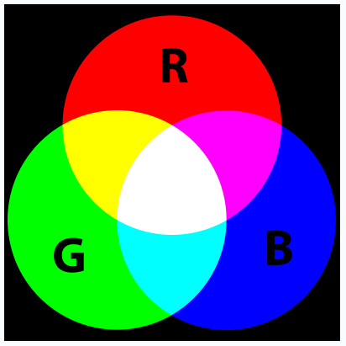
Primary Colors
Cone cell response
From Wikipedia,
“RGB Color Model”
How the primary song should go
“Additive color mixing”
(Pigments: “subtractive color mixing”)

Slide 6
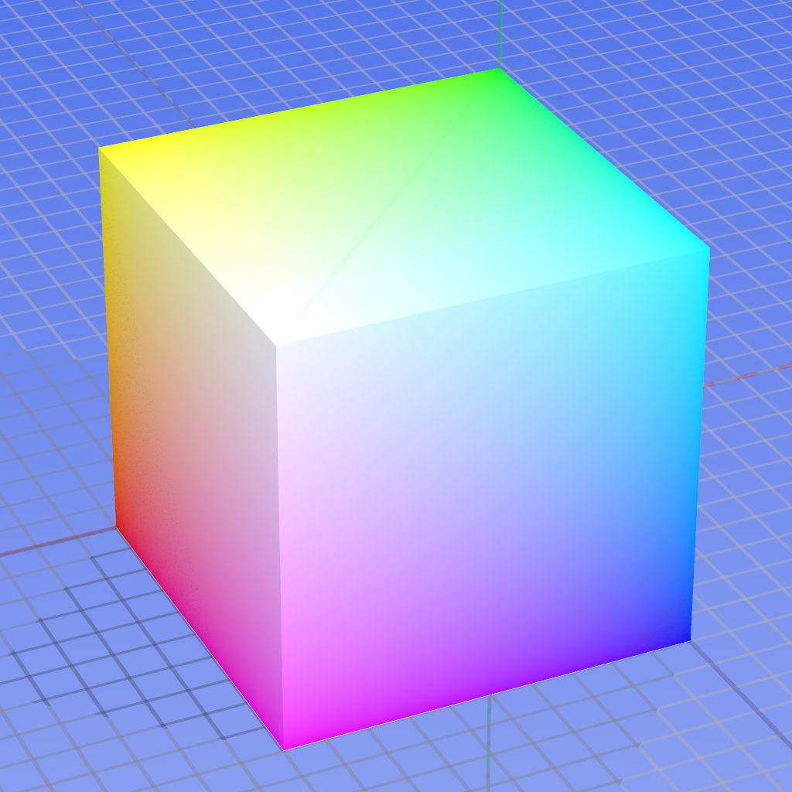
Components of R, G, B: Plot in 3D “color space”
From Wikipedia,
“RGB Color Model” (old version)
Viewing slices of the cube:
https://programmingdesignsystems.com/color/color-models-and-color-spaces/index.html

Slide 7
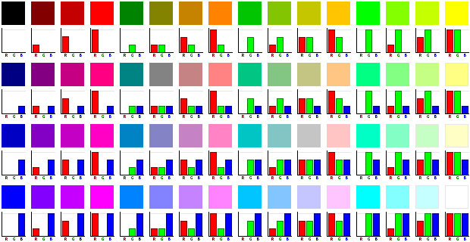
Components of R, G, B
From Wikipedia,
“RGB Color Model” (old version)

Slide 8
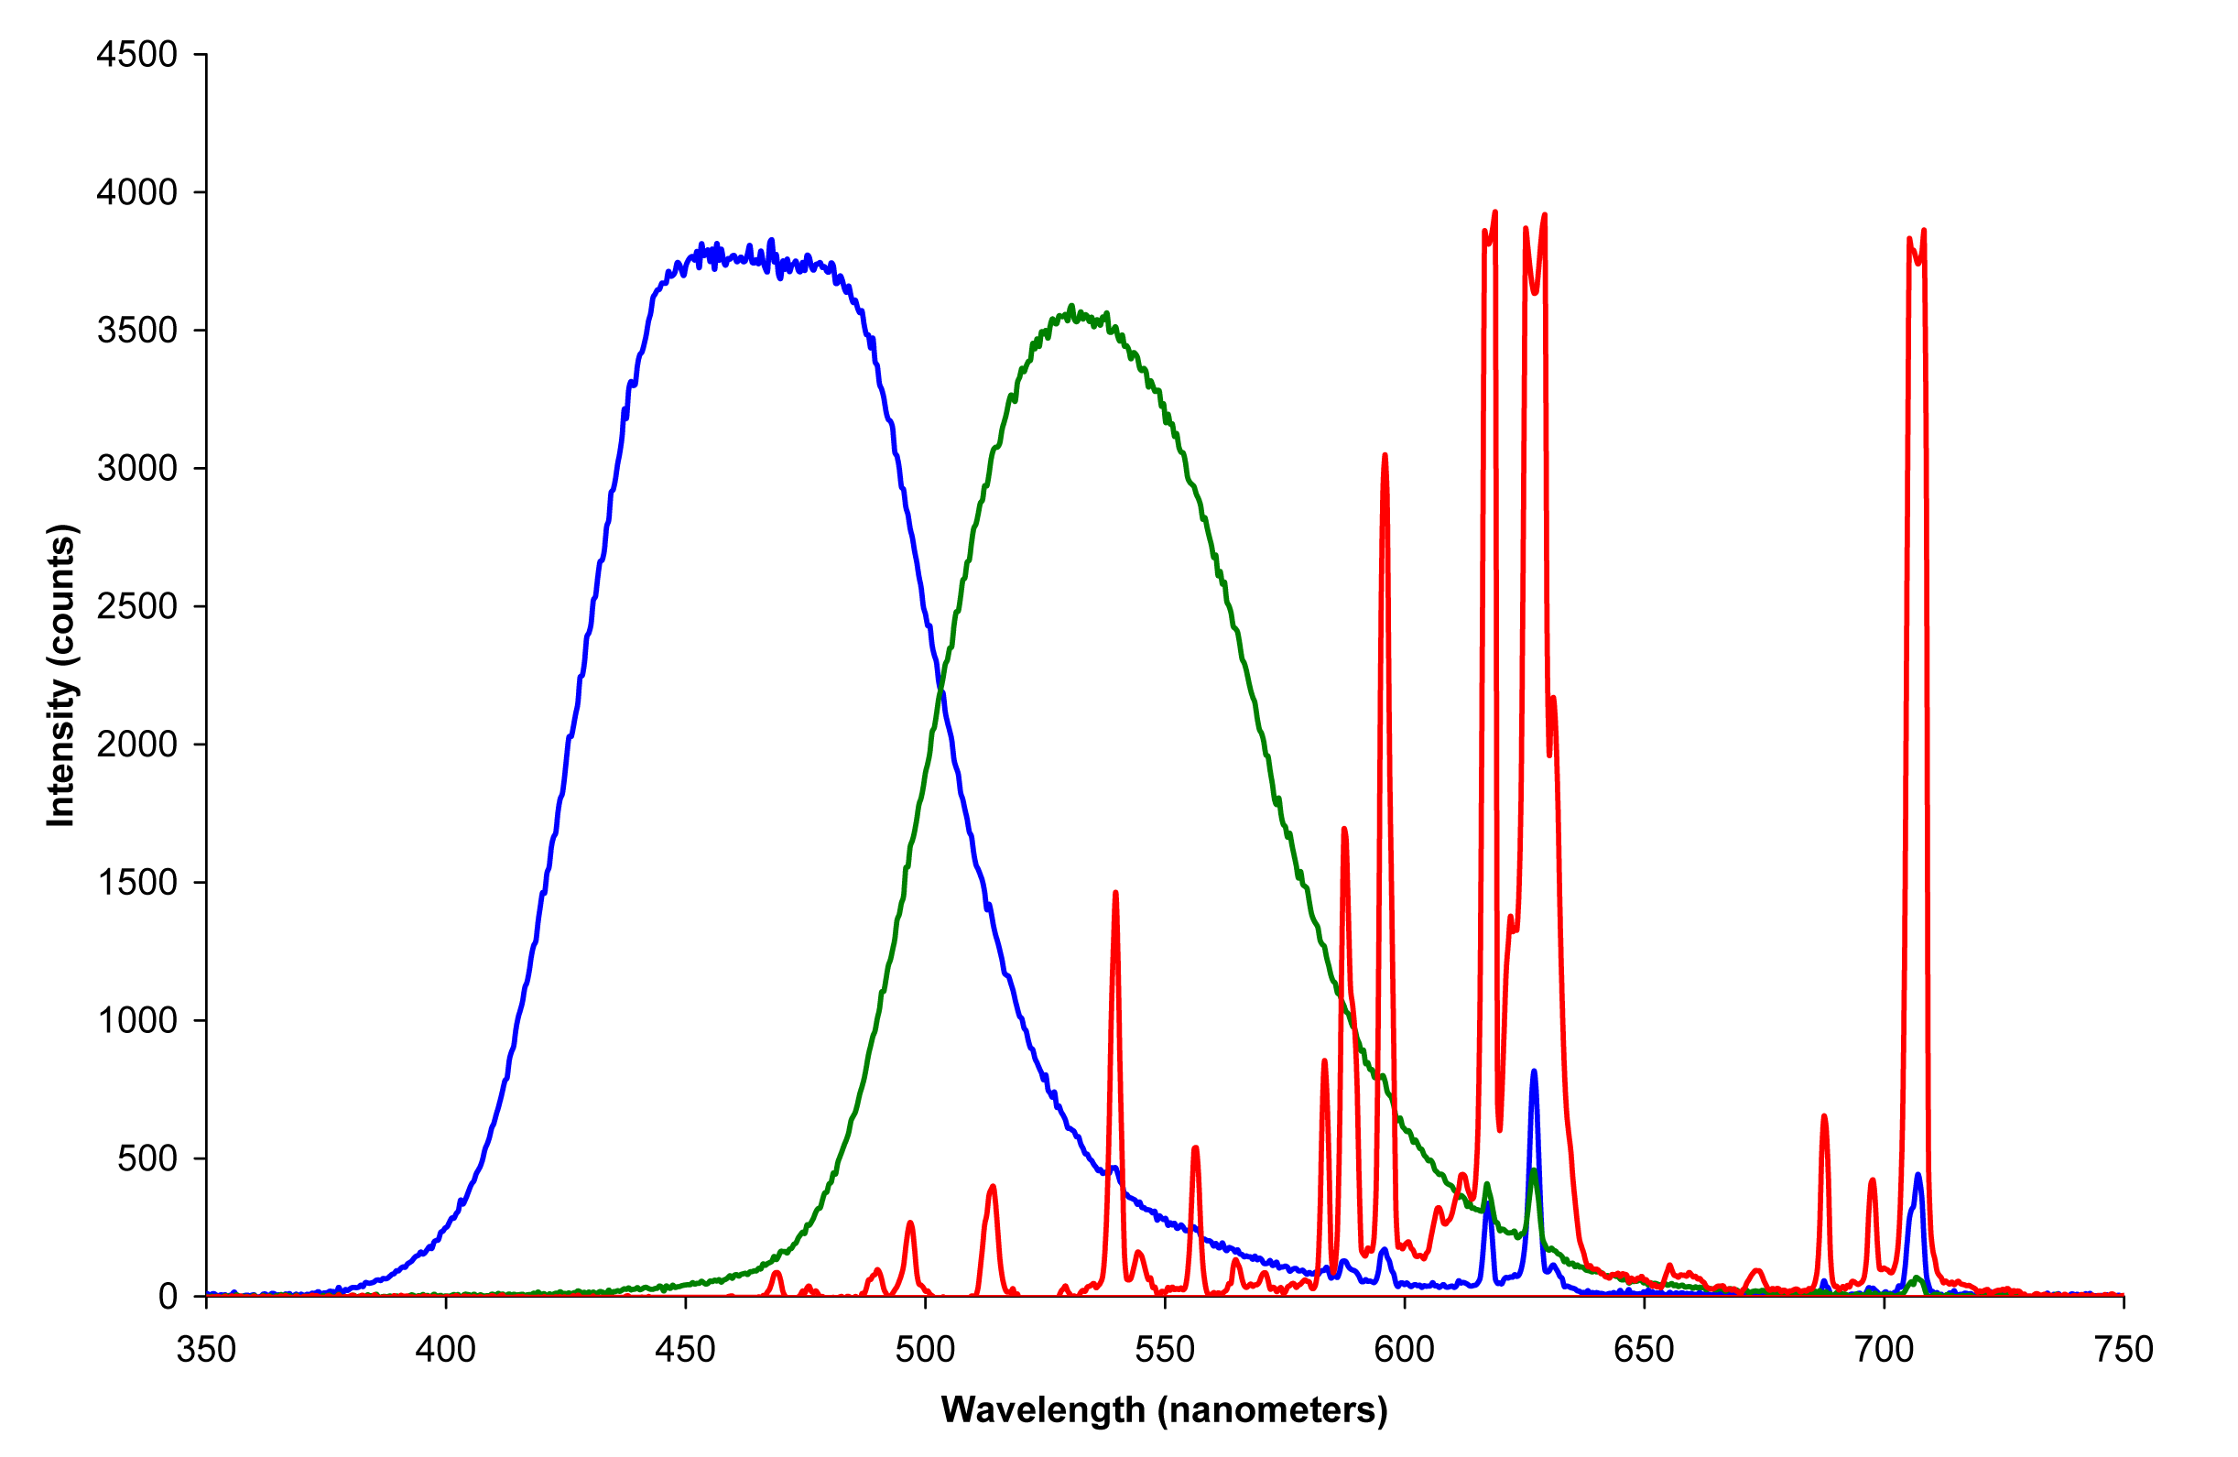
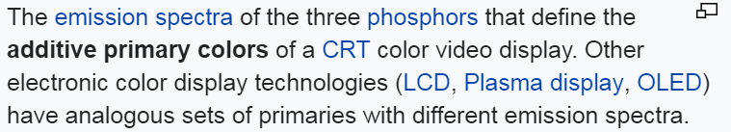
How to Display Colors
From Wikipedia, “Primary Color”

Slide 9
1920’s Color Matching Experiments
Using combinations of these three:
Narrow red source at 700 nm
Narrow green source at 546.1 nm
Narrow blue source at 435.8 nm
How much of each is required to match the wavelengths in the visible spectrum (“pure colors”)?
Cone cell response, again

Slide 10
A Concern
Cone cell response, again
Say you want to mix the dashed lines to look the same as 580 nm orange line.
You may start by turning up the red light. But soon you also need to turn up the green light. However…
Green light will excite some S! (a small amount, but nonzero)
580 nm alone will never excite S! Therefore 580 nm cannot be matched.
You need some “negative blue” to counteract

Slide 11
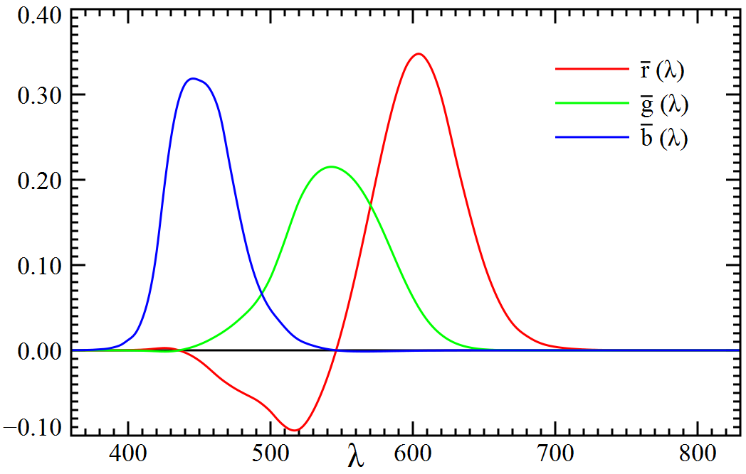


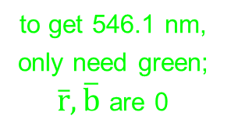
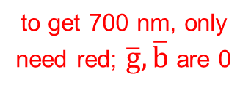
Results: $\overline{r}, \overline{g}, \overline{b}$ functions
red source = 700 nm green source = 546.1 nm blue source at 435.8 nm
to get 700 nm, only need red; $\overline{g}, \overline{b}$ are 0
to get 435.8 nm, only need blue; $\overline{r}, \overline{g}$ are 0
to get 546.1 nm, only need green; $\overline{r}, \overline{b}$ are 0
to get 580 nm orange, need some “negative” blue
From Wikipedia, “1931 Color Space” (also in P&W)

Slide 12
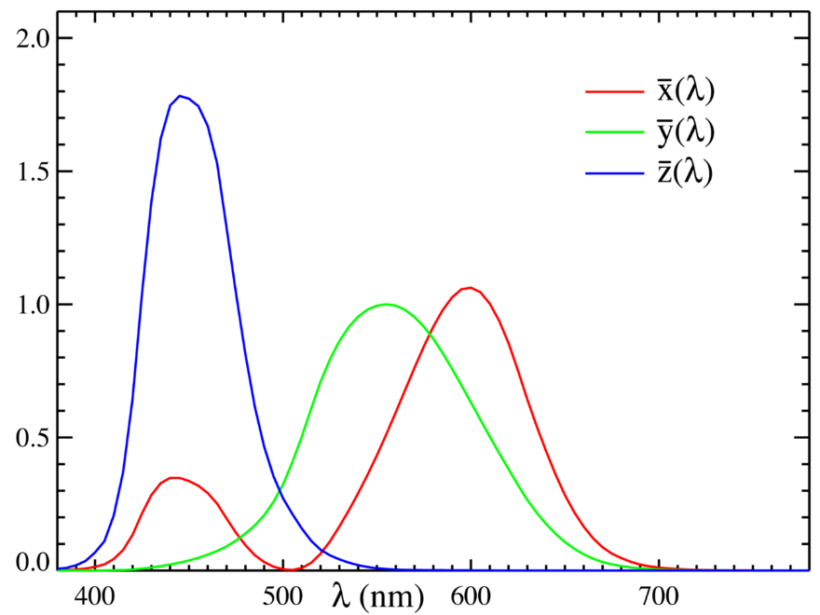
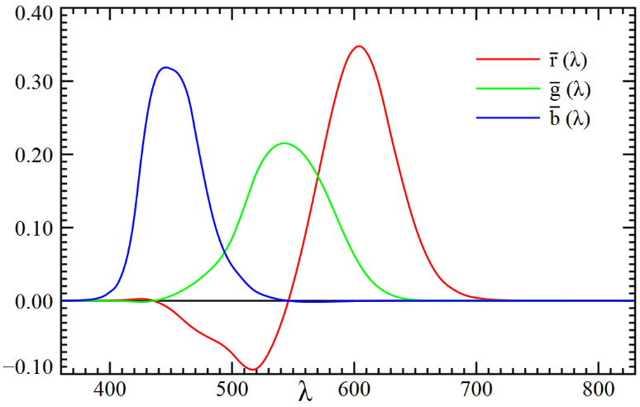


Better!! $\overline{x}, \overline{y}, \overline{z}$ functions
W/nm
From Wikipedia, “CIE 1931 Color Space”
(Very Important, but not in Peatross & Ware)
$\overline{x},\overline{y},\overline{z}$ properties
all are positive
$\overline{z}$ = close to S cones, close to $\overline{b}$
$\overline{y}$ = matches intensity response of eye, close to M cones. Normalized to 1.
$\overline{x}$ = chosen so that white is equal parts of all three
Cone cell response again

Slide 13

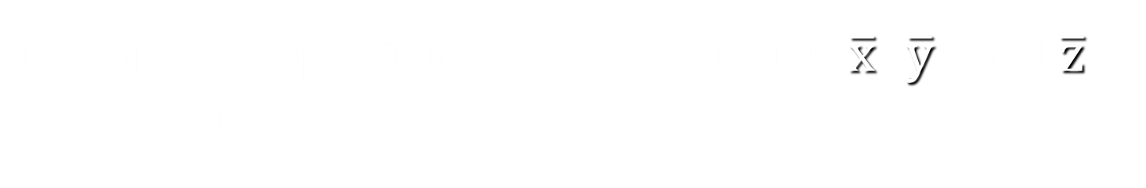

Projections
Given a spectrum I(λ), how much $\overline{x}$, $\overline{y}$, and $\overline{z}$ does it have?
$$X=\int{I\left(λ\right)\overline{x}\left(λ\right)dλ} \\ Y=\int{I\left(λ\right)\overline{y}\left(λ\right)dλ}$$
$$Z=\int{I\left(λ\right)\overline{z}\left(λ\right)dλ}$$

Slide 14








Worked Example, Like P2.13
Note 1: the functions were changed in 2006. For HW problem, use functions given on https://optics.byu.edu/resources
(link provided in textbook)
Note 2: as explained in my instructions for P2.13,
"luminous power" (in lumens) $=683×\int{I\left(λ\right)\overline{y}\left(λ\right)dλ}$
$=683×Y$
~15
X =
Y =
Z =
Normalize so they add up to 1 (“color” should not depend on overall intensity)
x =
y =
z = 1 – x – y =
~12
0
15/27 = 0.56
12/27 = 0.44
These are the chromaticity coordinates!!
0

Slide 15

Another Worked Example
What is (x,y) for a delta function at 560 nm?
My estimates:
X = 0.59
Y = 0.98
Z = 0
x = 0.38
y = 0.62
Do that for every wavelength → the “locus” curve

Slide 16

Chromaticity Diagram
Things to observe
Example 2: 560 nm = (0.38, 0.62)
The locus curve
Example 1: (0.56, 0.44)
The white point = (0.33, 0.33)
“Line of purples”
Linear effects
Color mixing along line connecting two points
“Hue”: pure wavelength which can mix with white to get the point. Example: $470$ nm
“Complementary color”: color that can mix with the point to get white. Example: $λ_{C}=573$ nm
(0.38, 0.62)
(0.56, 0.44)
(0.33, 0.33)

Slide 17
Chromaticity Diagram
Saturation: How close is the point to its hue?
Example 1: 18%
Example 2: 65%
Brightness
Overall intensity, Not on this diagram

Slide 18
Remember this?

Slide 19
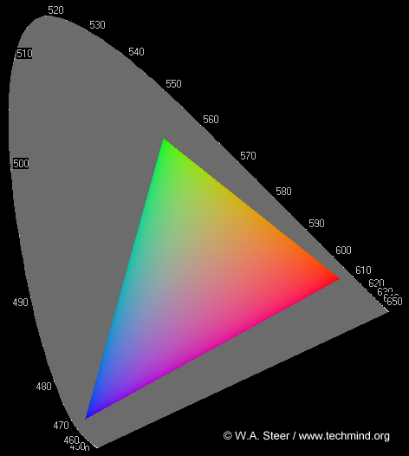
sRGB: three specific color sources
Standard created in 1996 by HP and Microsoft to help the internet
Mixing three sources: triangle called the “gamut”
“green” = (0.30, 0.60)
“red” =
(0.65, 0.33)
“blue” = (0.15, 0.06)

Slide 20
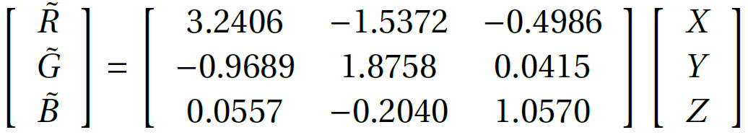
XYZ to sRGB
From P&W P2.14
Step 1: linear transformation
Step 2: apply nonlinear function because eyes respond logarithmically (given in P2.14)
Normalize R,G,B values to be integers from 0 to 255
256×256×256 = 16,777,216 possible colors
“green” = (0.30, 0.60)
“red” =
(0.65, 0.33)
“blue” = (0.15, 0.06)

Slide 21

xyY
Reminder: what was Y?
all are positive
$\overline{z}$ = close to S cones, close to $\overline{b}$
$\overline{y}$ = matches intensity response of eye, close to M cones
$\overline{x}$ = chosen so that white is equal parts of all three

Slide 22

XYZ ↔ xyY Transformations
$\left[\begin{matrix}x \\ y \\ Y\end{matrix}\right]=\left[\begin{matrix}\frac{X}{X+Y+Z} \\ \frac{Y}{X+Y+Z} \\ Y\end{matrix}\right]$
$\left[\begin{matrix}X \\ Y \\ Z\end{matrix}\right]=\left[\begin{matrix}\frac{x}{y}Y \\ Y \\ \frac{1−x−y}{y}Y\end{matrix}\right]$

Slide 23
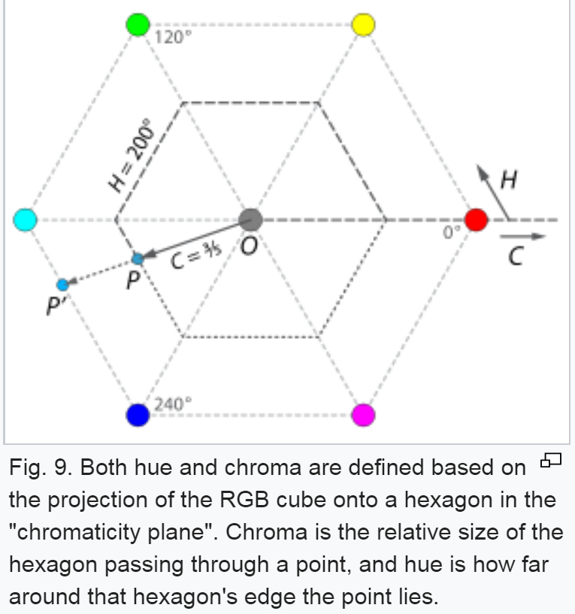
“Hue, brightness, saturation”
Hue – use RGB values to turn locus into a hexagon, then written as 0 to 360°
Saturation called “chroma”, as before
Brightness from Y, scaled as 0 to 1
From Wikipedia “HSL and HSV”

Slide 24
sRGB gamut, again
How would you get this color using sRGB?
What would be the ideal set of three light sources for your monitor to give you as many colors as possible in the gamut?
“green” = (0.30, 0.60)
“red” = (0.65, 0.33)
“blue” = (0.15, 0.06)

Slide 25
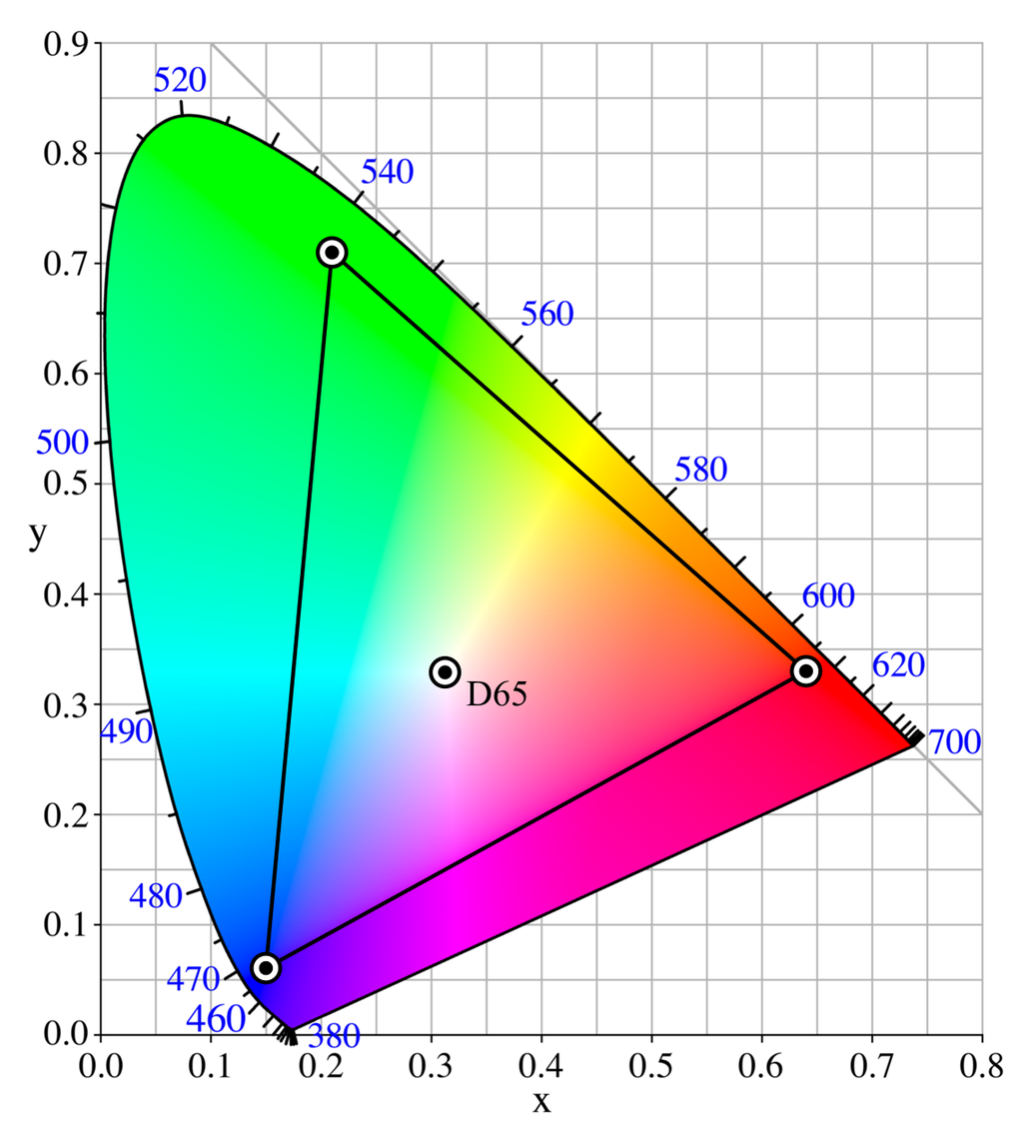
Adobe RGB
Better than sRGB?
Only if your camera/display/ printer are all calibrated for it
Not for use on internet
Also: there’s a wider range of possible colors, but the difference between individual colors is bigger than in sRGB (still 256×256×256)
P
From Wikipedia,
“Adobe RGB color space”

Slide 26
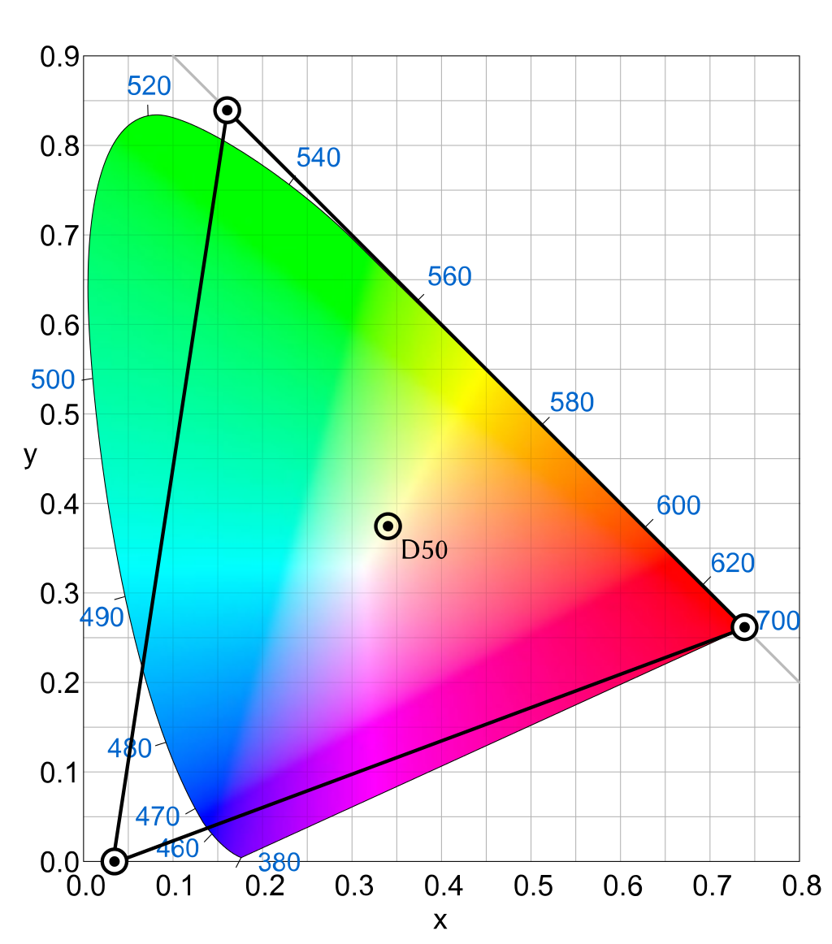
ProPhoto RGB
“One of the downsides to this color space is that approximately 13% of the representable colors are imaginary colors that do not exist and are not visible colors.”
P
From Wikipedia,
“ProPhoto RGB color space”

Slide 27


Summary
Three types of cones: short, medium, long
Three dimensional color space: RGB
“Color matching functions”: $\overline{r}, \overline{g}, \overline{b}$
Alternate functions: $\overline{x}, \overline{y}, \overline{z}$
$\overline{y}=$ overall response
$\overline{z}$ is basically $\overline{b}$
$\overline{x}$ makes white light have equal parts
Projections of spectrum: X,Y,Z values
Normalized X,Y,Z values: x,y,z
Chromaticity coordinates: x,y
Chromaticity diagram
→ Locus, gamut, linear effects, complementary colors, etc.
Other ways to specify coordinate in 3d space:
x,y,Y; hue, saturation, Y; hue, brightness, saturation; sRGB coordinates; other color spaces

