Slide 1
Nanocrystals inside Ferritin inside Photovoltaic Cells
Kameron Hansen, Brigham Young University
Co authors:
John Colton (advisor)
Richard Watt (advisor)
J Ryan Peterson
Cameron Olsen
Alessandro Perego
Luis Perez
Heather Hogg

Slide 2
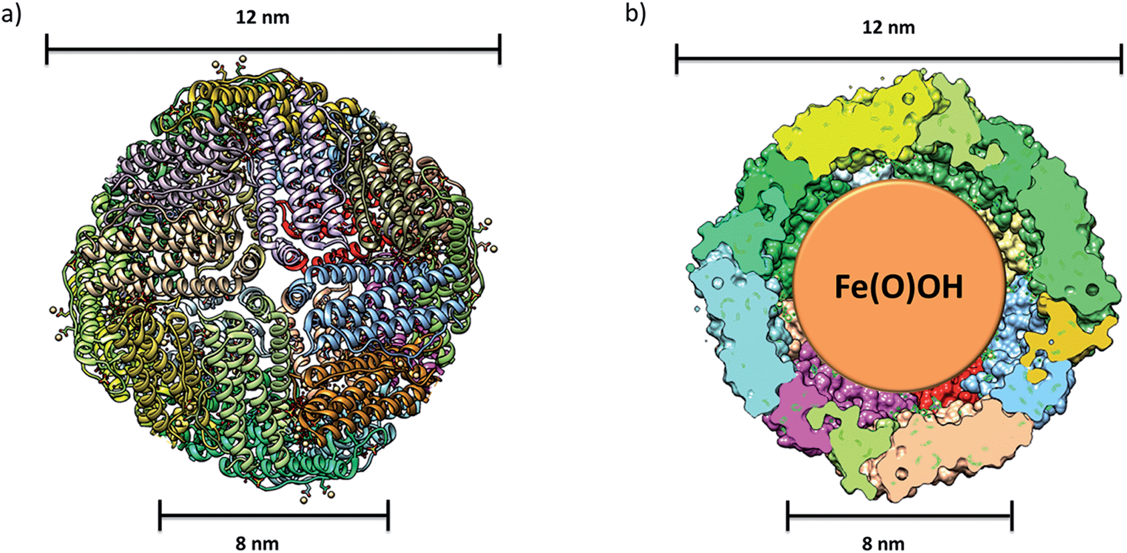
Before I joined the group… there was a hypothesis
12 nm
12 nm
Ferritin
8 nm
8 nm
Reference: J. Mater. Chem. A, 2014, 2, 20782-20788

Slide 3
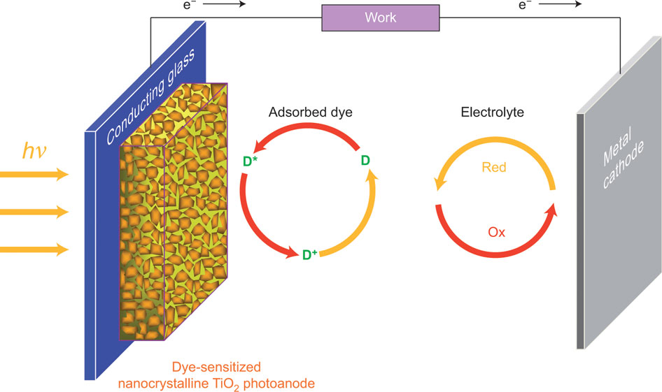
Dye Sensitized Solar Cell
Semiconductive dye on porous TiO₂
Electrolyte
Reference: Nature Chemistry 3, 188–189 (2011)

Slide 4
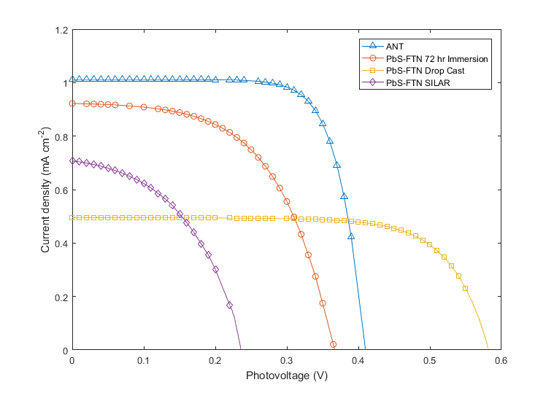
Power efficiency of PbS nanocrystals
 | η (%)
Control | 0.43
Staining method 1 | 0.26
Staining method 2 | 0.28
Staining method 3 | 0.11
Current (mA)
Voltage (mV)

Slide 5
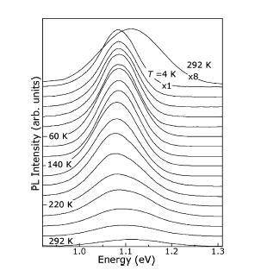
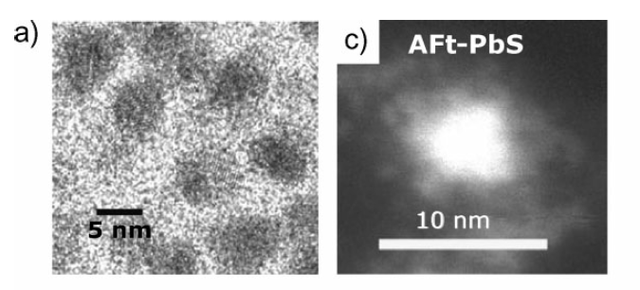
Attention Diverted...
Hennequin, et al.
Advanced Materials 20.19 (2008)

Slide 6
2 main results:
1 – Simplified synthesis of PbS nanocrystals inside ferritin
2 – Achieved synthesis of PbSe nanocrystals inside ferritin

Slide 7
PbS and PbSe inside Ferritin
Inhibit growth of cancerous cells
Catalyst in hydrogen evolution
Biological Imaging

Slide 8
Colloidal Synthesis
Ferritin in Sodium Acetate
Lead
Sulfur/Selenium
After Lead
After Sulfur/Selenium

Slide 9
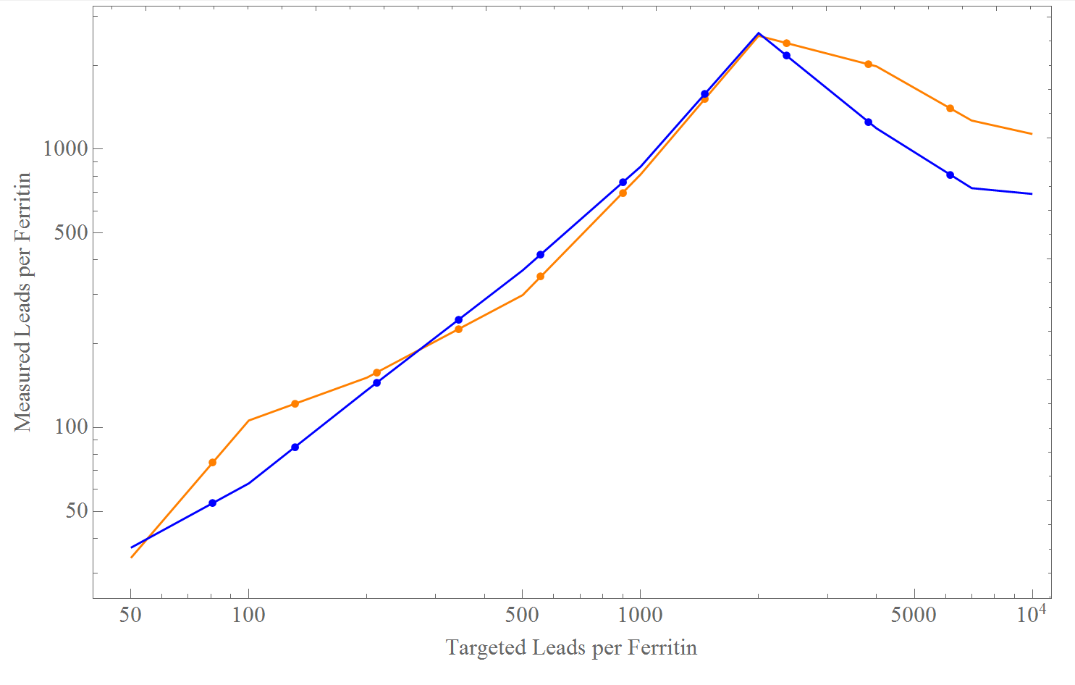
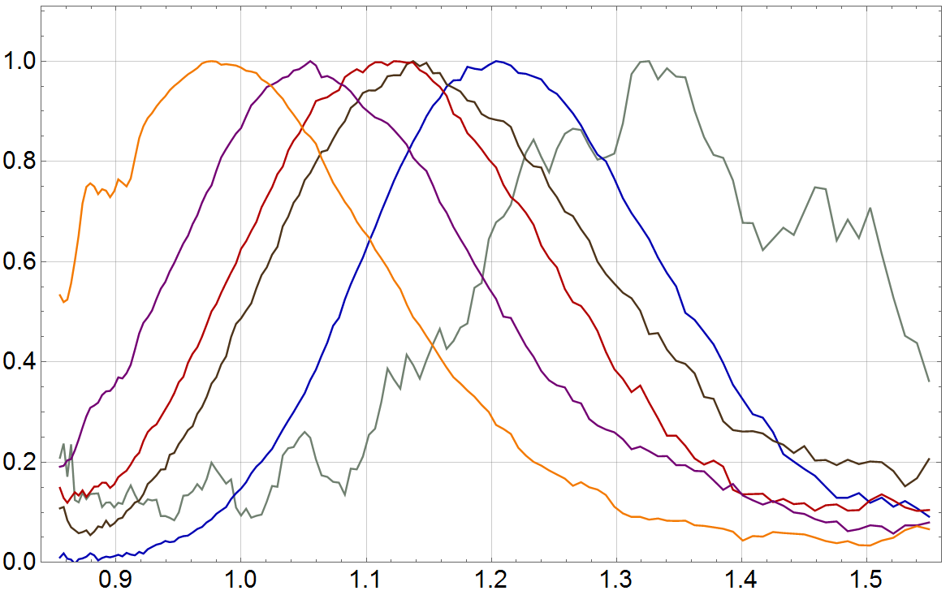
Simplified PbS
6.10 nm
3.03 nm
2.25 nm
Room Temp. Photoluminescence
Aerobic
Anaerobic
Measured Lead per Ferritin
Targeted Lead per Ferritin
Photon Energy (eV)

Slide 10
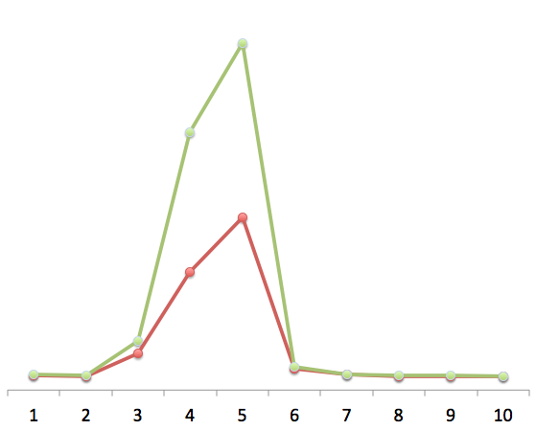
PbSe Size-Filtration Gel
Lead
Protein
Concentration
Fractions 1-10 (by size)

Slide 11
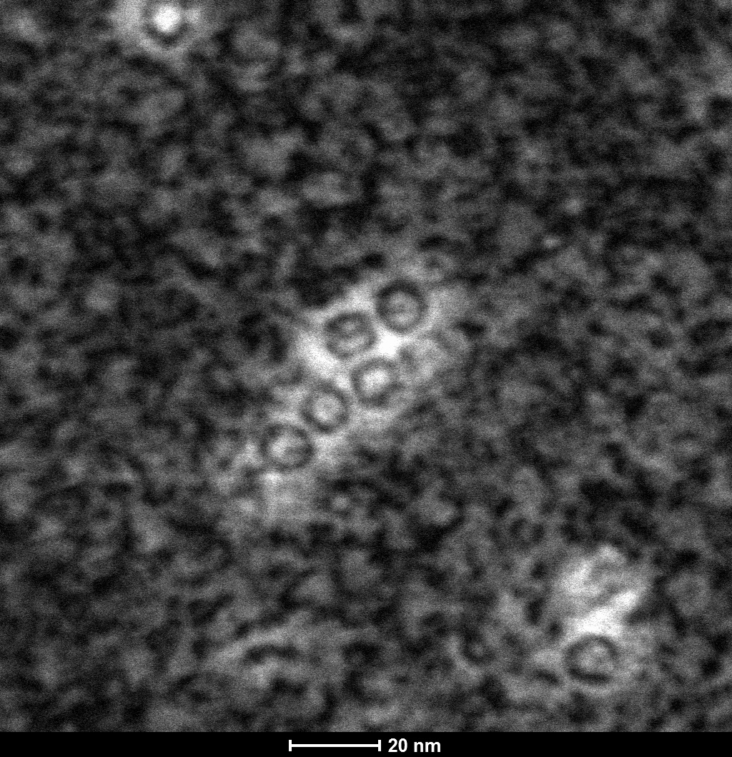
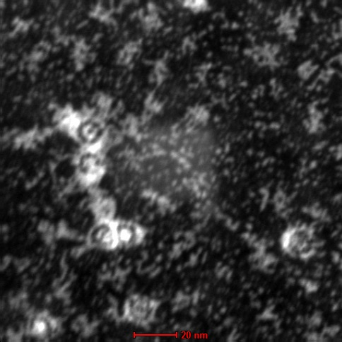
PbS inside Ferritin PbSe inside Ferritin
20 nm
20 nm
Ferritin Protein
Ferritin Protein
PbS Core
PbSe Core
5 nm

Slide 12
Conclusion - 2 main results
1 - Simplified PbS synthesis
2 - Achieved PbSe synthesis
Future work:
Optimize PbSe synthesis
Dye sensitized solar cell fabrication
Notes:
1) Developing synthesis of PbSe
2) Simplified the synthesis of PbS

