Slide 1
Optically detected magnetic resonance of silicon vacancies in SiC
Kyle Miller, John Colton,
Samuel Carter (Naval Research Lab)
Brigham Young University Physics Department

Slide 2
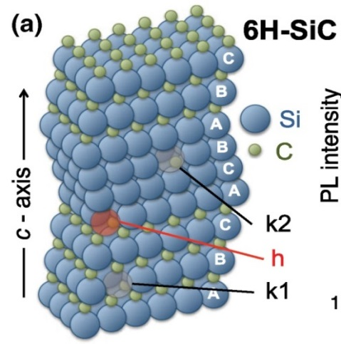
Background: Defects in SiC
The goal is to use silicon carbide defects for quantum information purposes (qubits)
SiC is cheaper than diamond and can be grown on a lattice
Defects occur where a silicon atom is missing
Determine spin coherence time of electrons in defects
From Riedel et al., Phys. Rev. Lett. 109, 226402 (2012)

Slide 3
Background: Electron spins and ODMR
S=3/2 system
⁴E
±3/2
Metastable
doublet
±1/2
m_{s}=+3/2
Energy
m_{s}=+1/2
optical
2D
Non-radiative
m_{s}=-1/2
m_{s}=-3/2
⁴A
±3/2
B
±1/2
From Sam Carter
See P. G. Baranov et al., Phys. Rev. B 83, 125203 (2011)
Laser promotes electrons to higher energies
Non-radiative transition causes the m_{s}=1/2 state to populate faster
Microwaves equalize spin populations, causing a decrease in the observed photoluminescence (PL)

Slide 4
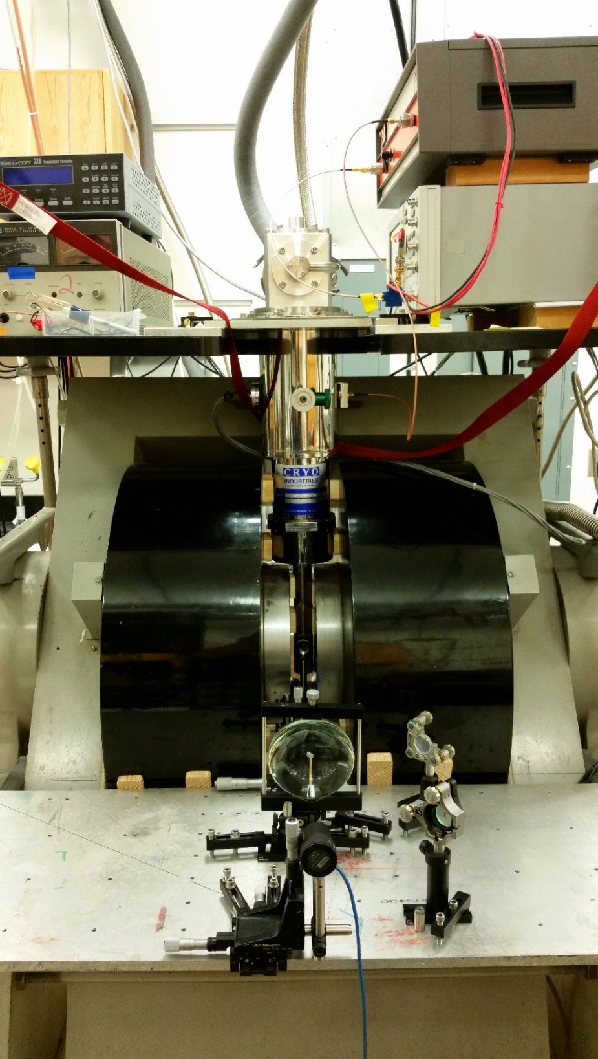
Experimental Setup
Cryostat
Place sample in cryostat, temperature as low as 6 K
Electromagnet provides localized field of up to 1.36 T
Microwave source combined with amplifier outputs more than 25 W
0.7 W of 870 nm laser hitting the sample
µwave
source
Electro-
magnet
Laser
B_{µwave}
SiC
B₀

Slide 5
Maximizing microwave power
Coupling loop is made from the inner conductor of the coax
Sample placed directly on the copper cold finger
Laser
B_{µwave}
SiC
B₀

Slide 6
Maximizing microwave power
Stub tuners, or “slide trombones”, help tune standing wave patterns
They match the impedance of the loop for maximum radiation output
Double stub
Single stub

Slide 7
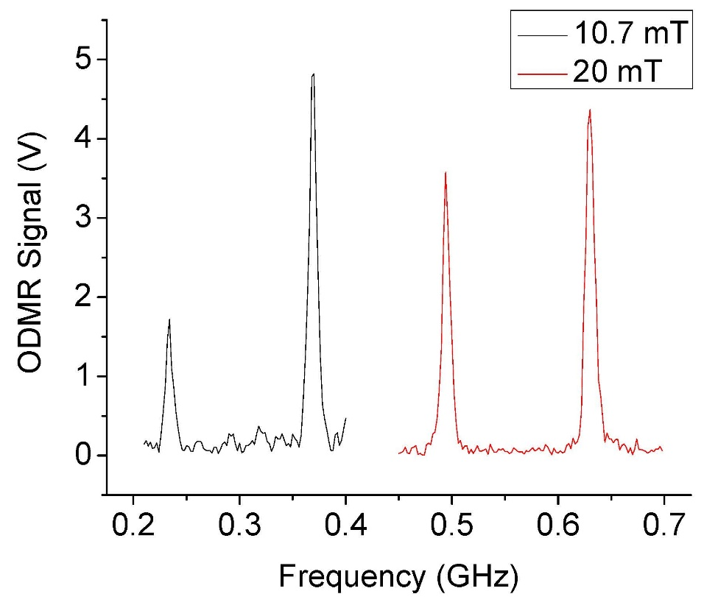
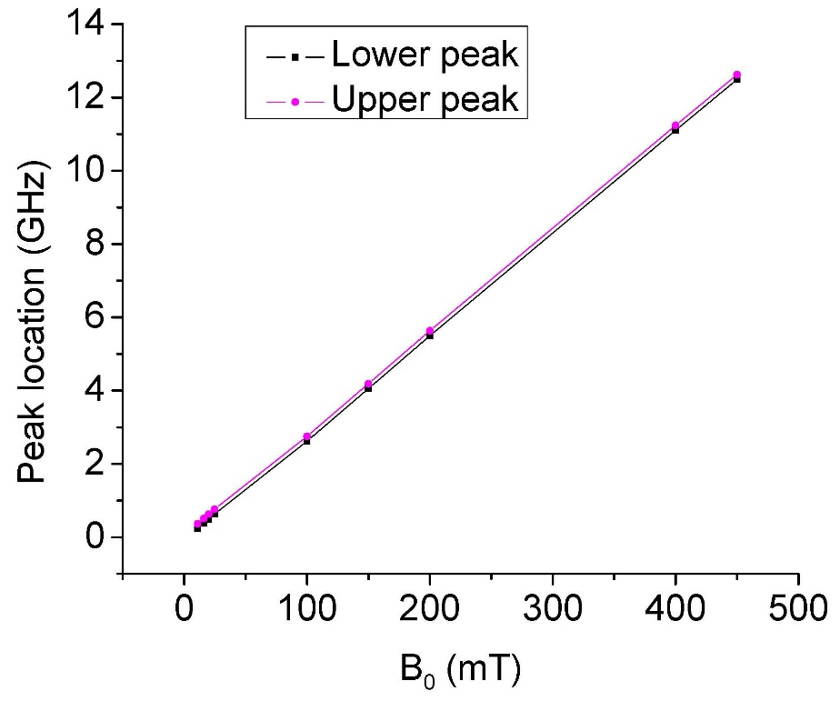
ODMR
Two resonant peaks, one varies in strength
Linear field dependence
$$hf=gμ_{B}B$$
$$\frac{f}{B}=\frac{gμ_{B}}{h}$$
$$g≈1.996$$
Very close to 2

Slide 8
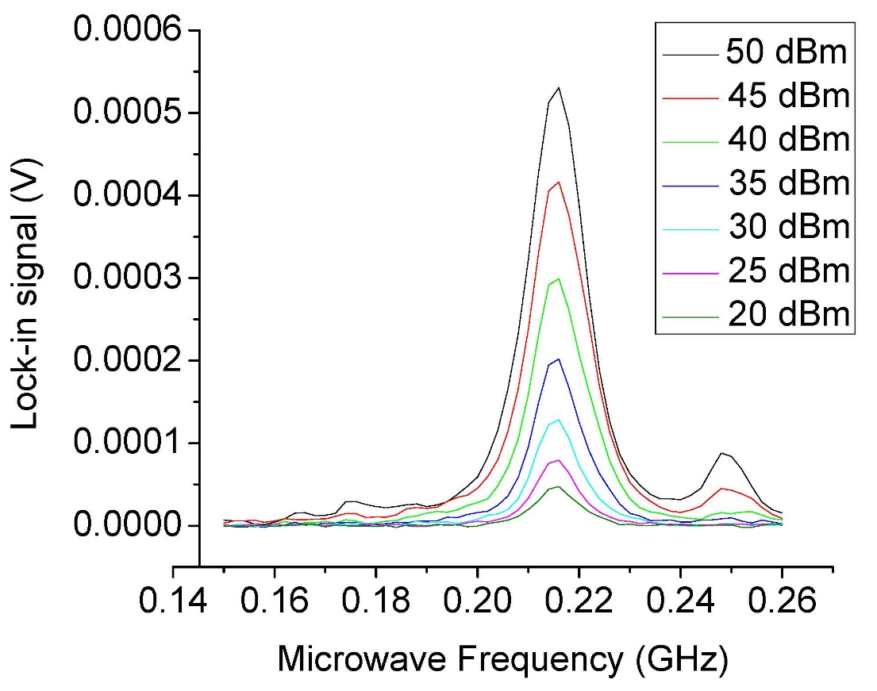
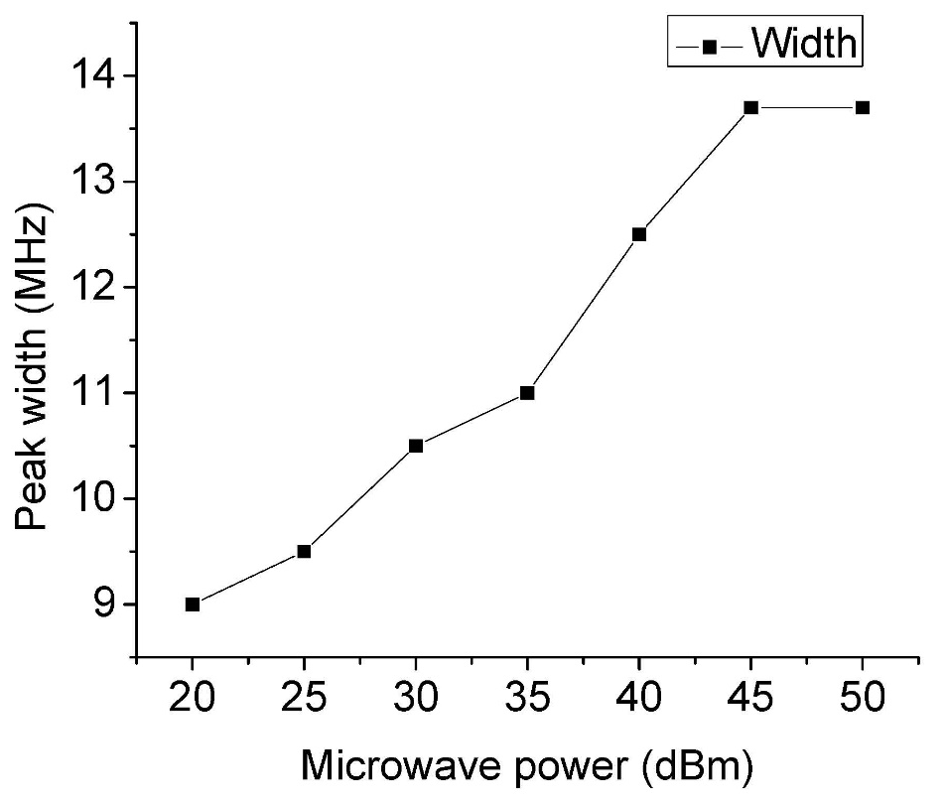
ODMR – Microwave power
Increased response with increased microwave power
Width also increases

Slide 9
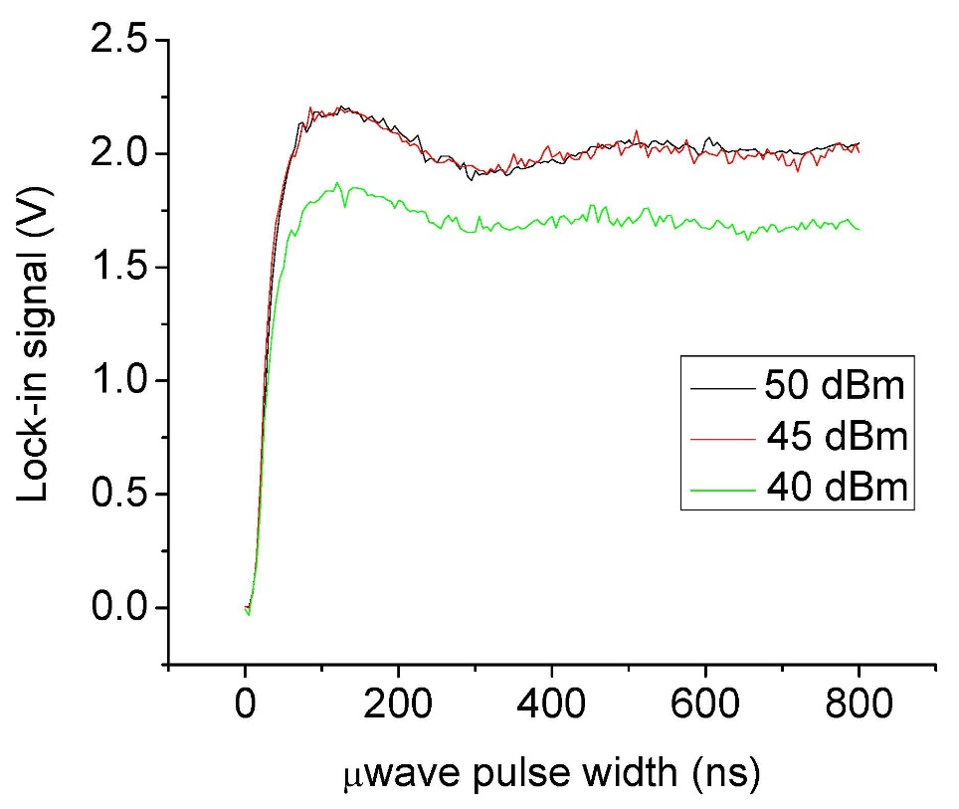
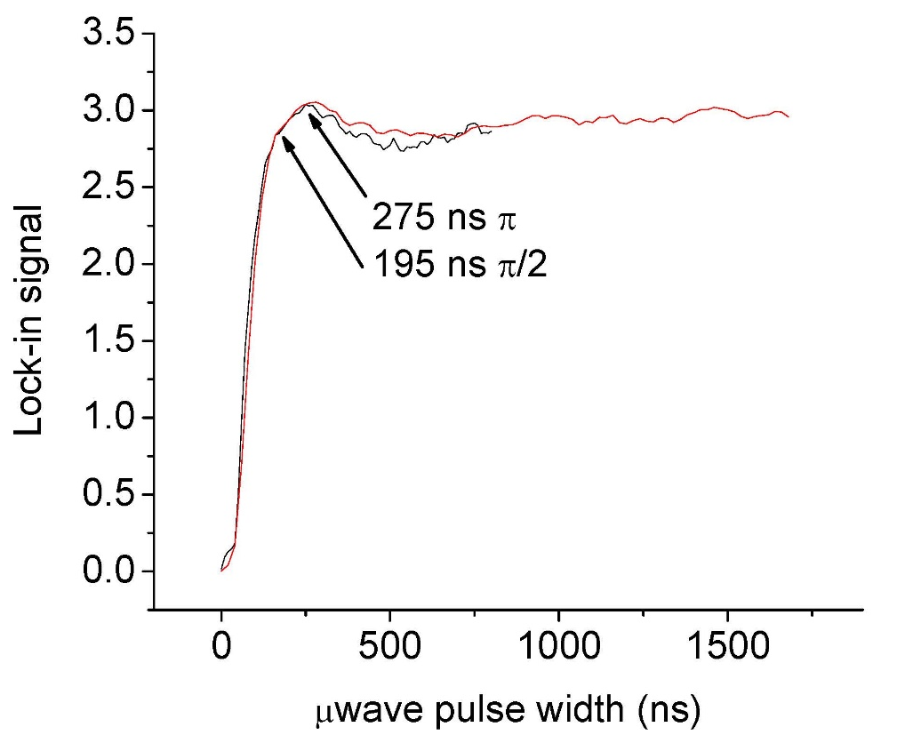
Rabi oscillations
5 µs
Vary length
(0 – 1000 ns)
1 µs
Laser
Laser
These occur when electrons are switched continuously up and down between spin states (See video)
Stronger microwave power means faster oscillations
This gives $π$ and $π/2$ pulses (which flip spins upside down and half-way upside down)
250 MHz
207 MHz

Slide 10
Spin echo
20 µs
2 µs
$$T_{fixed}$$
Laser
$$\frac{π}{2}$$
$$π$$
$$\frac{π}{2}$$
Laser
$$t_{ramsey}$$
Set $T_{fixed}$, then vary $t_{ramsey}$ to observe the signal
Microwave pulses manipulate spin orientation
Signal is seen when pulses are equally spaced
See video
"HahnEcho GWM" by GavinMorley - Gavin W Morley. Licensed under Creative Commons Attribution-Share Alike 3.0 via Wikimedia Commons - http://commons.wikimedia.org/wiki/File:HahnEcho_GWM.gif#mediaviewer/File:HahnEcho_GWM.gif

Slide 11
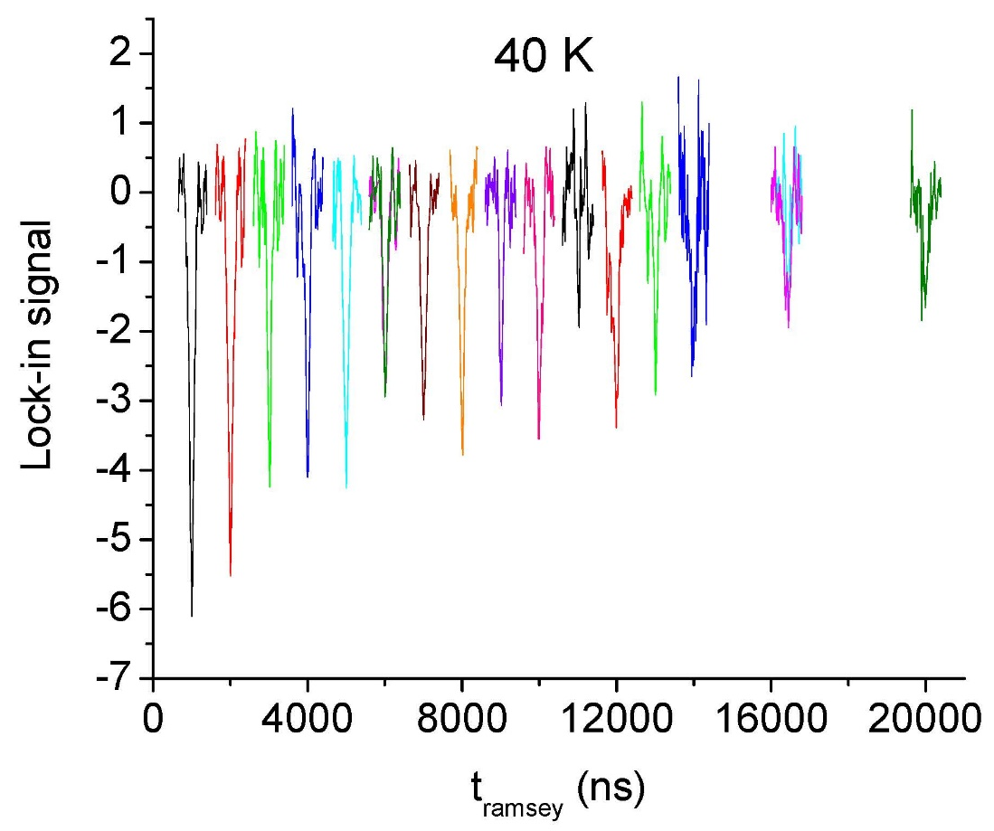
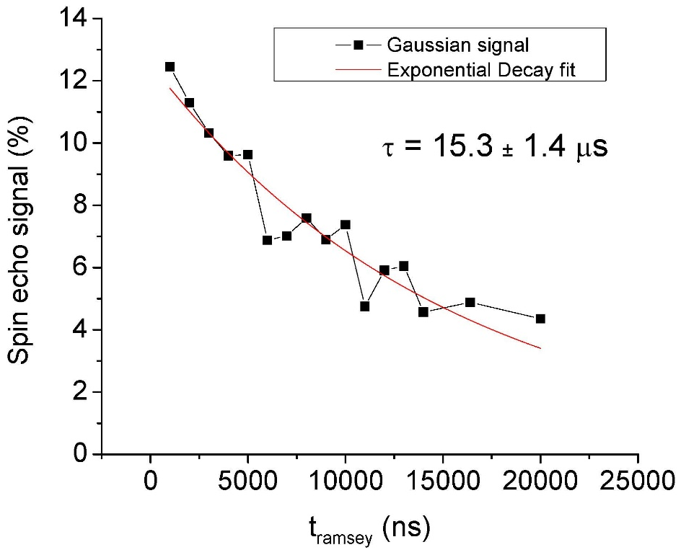
Spin echo data
Exponential decay of the signal predicts $T_{2}$
Important figure is the percentage of the way toward 0

Slide 12
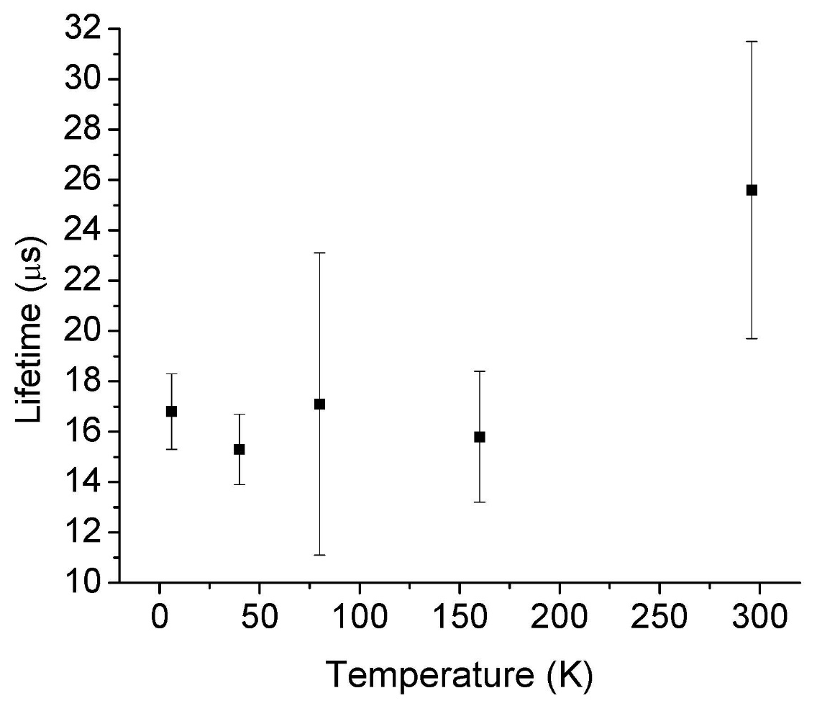
Calculating T₂
Fitting the exponential decay of the spin echo signal gives T₂
Echo signal, 40 K

Slide 13
Summary
Spin coherence time $≈16μs$
Is this long?
Pretty good. Long for GaAs, not super long for diamond
Can we get longer?
Apparently not with temp, maybe with defect concentration
What is the limiting factor on the lifetime?
Future work
Try different samples with varying amounts of defects from irradiation
NSF Grant PHY1157078

