Slide 1
Efficiency of Dye-Sensitized Solar Cells using Ferritin-Encapsulated Quantum Dots with Various Staining Methods
Presented by: Luis Perez
Main Contributors: Dr. John S. Colton, Kameron Hansen,
J. Ryan Peterson

Slide 2
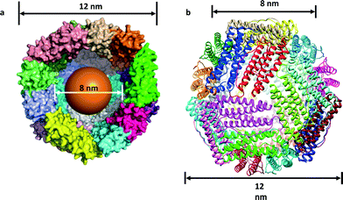
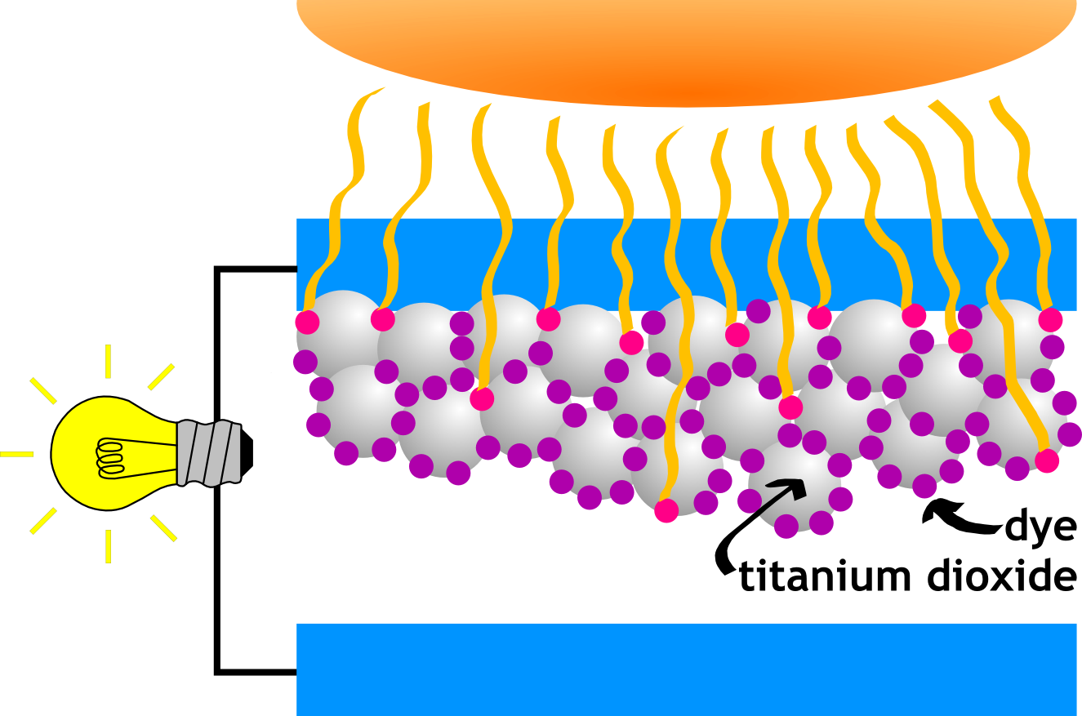
Introduction
Ferritin (FTN) used in dye-sensitized solar cells:
Anatomy of a DSSC:
anode
Electrolyte
cathode

Slide 3
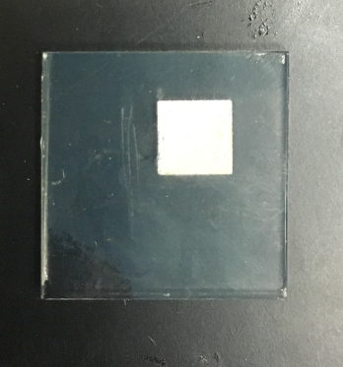
Introduction (continued)
Benefits of using ferritin as a capping agent:
Environmentally and economically friendly
Help with stability
Uniform core growth
Electron transport channels
Ability to prevent photocorrosion
Thermo-stable (up to 80ºC)
Theoretical efficiency ≈ 38%→ multi-junction
Various staining methods with FTN-PbS:
Traditional Immersion
Successive ionic layer adsorption and reaction (SILAR)
TiO₂

Slide 4
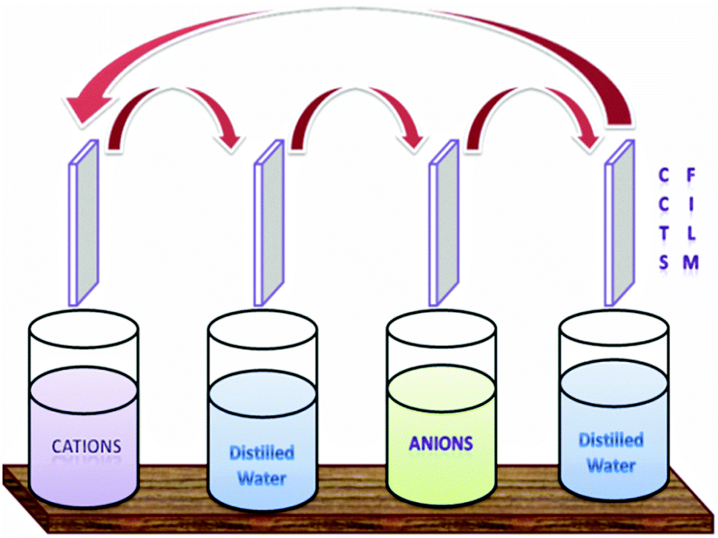
Procedures of Various Staining Methods
Traditional Immersion Method
PbS cores are synthesized with empty HoSF in slightly acidic sodium acetate buffer at room temperature
After centrifuging, solution is diluted to specified concentrations (0.1 mg/mL) with a TRIS HCl buffer
Electrode is soaked in diluted solution for 72 hours
SILAR
Preparation of anionic and cationic solutions
- Cationic solution: Pb(AcO)₂ synthesized inside of FTN
Anionic solution: Na₂S
2. Dipped in cationic solution, rinsed, dipped in anionic
solution, rinsed

Slide 5
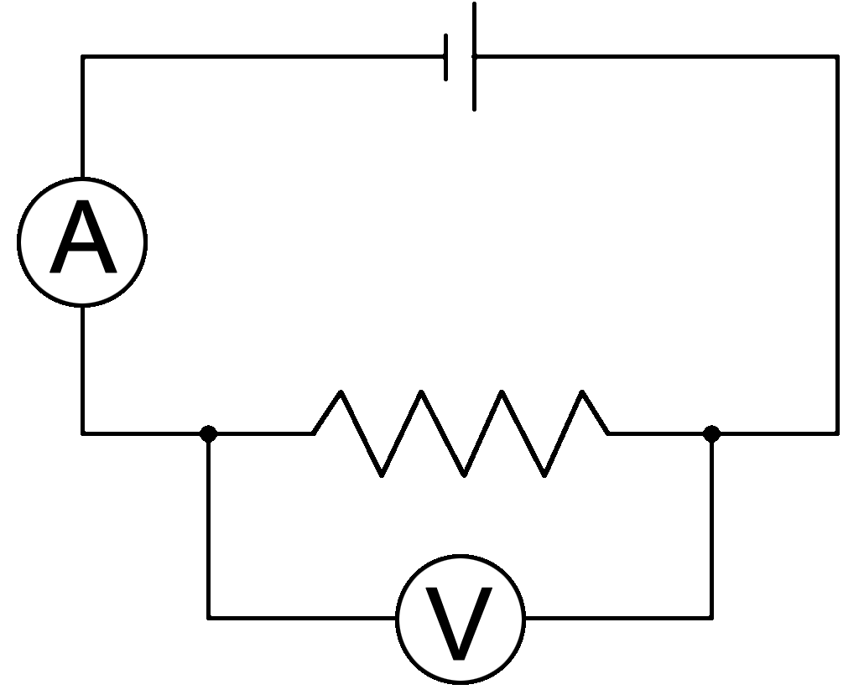
Calculating Efficiency ($ƞ$)
$ƞ=\frac{(I∙V)_{max}}{(Incident Intensity)∙(cell area)}$
Ƞ measured using a varying resistance (5 to 5000 Ω) while the DSSC was illuminated with a 150 W Xe arc lamp
Subsequently, an I-V curve was produced

Slide 6
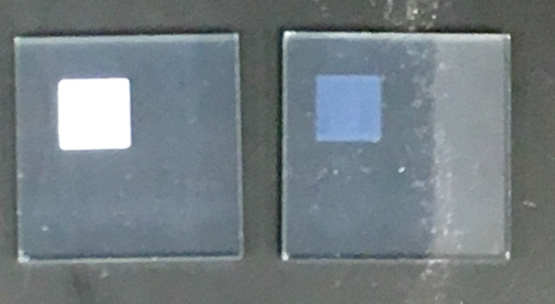
Obstacles
Transparent vs. Opaque TiO₂ electrodes
Issues with the Mathematica code
Active solar cell area
Intensity of light at DSSC location
$$ƞ=\frac{(I∙V)_{max}}{(Incident Intensity)∙(cell area)}$$
OpaqueTiO₂
TransparentTiO₂

Slide 7
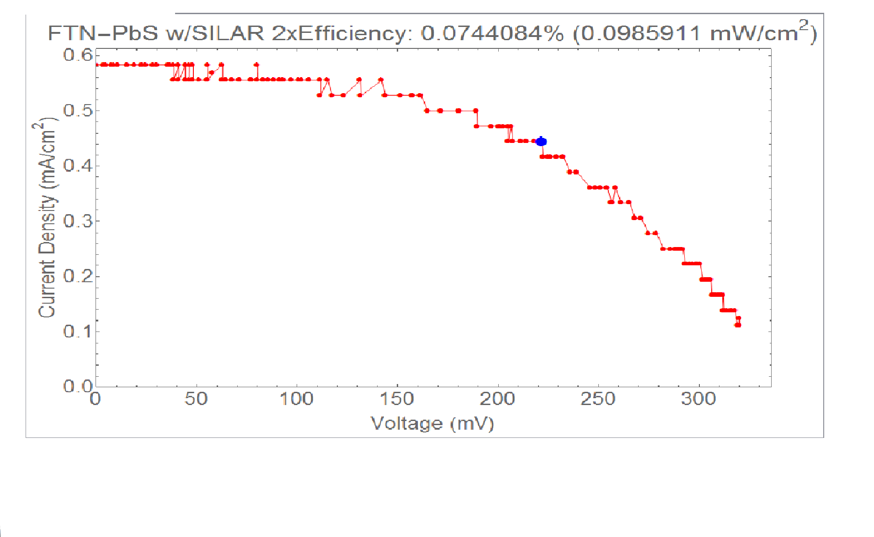
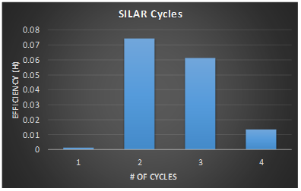
SILAR
Highest efficiency produced using SILAR→0.103%
How many cycles yields the highest efficiency?

Slide 8
SILAR vs. Immersion Method
Once errors were accounted for, both methods yielded similar efficiencies
Traditional Immersion Method: Time elapsed→72 hours
SILAR: Time elapsed→≈ 10 minutes

Slide 9
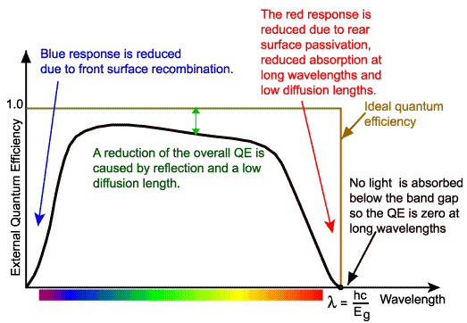
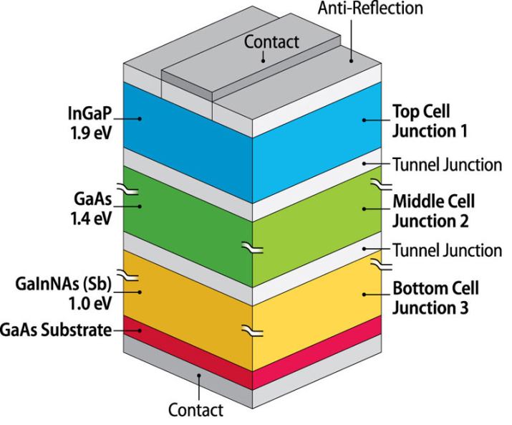
Future Work
Quantum efficiency
$$Q.E.=\frac{\# of electrons}{\# of photons}=\frac{J_{sc}}{Φ(λ)}∙\frac{hc}{e}∙\frac{1}{λ}$$
Concentrations relationship to Ƞ
Looking far into the future…multi-junction solar cells with FTN

Slide 10
Summary
What was covered:
Synthesis of nanoparticles inside of FTN
Anatomy of a DSSC
Procedures for multiple staining methods
Results for SILAR
SILAR vs. Immersion
Future work
Acknowledgments: I’d like to thank the following people for their support: Dr. John S. Colton, Ryan Peterson, Kameron Hansen and the National Science Foundation for funding

